Slide 1
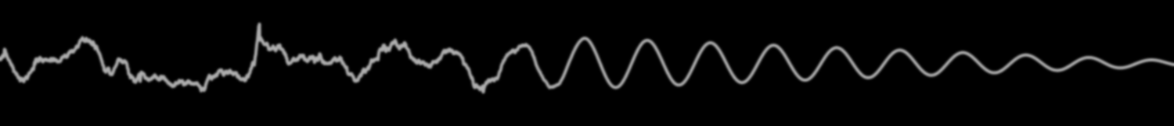
PhD Defense
Understanding Vehicle-Bridge Interaction through Field Measurements and Model-Based Simulations
John B. Braley
Department of Civil & Environmental Engineering
School of Engineering
Rutgers, The State University of New Jersey
April 26, 2019

Slide 2
Outline
Background & Context
Case Structure
Modeling VBI
Influential Parameters & Mechanisms
Applications in VBI
Smoothing
Traffic & Truck Platoons

Slide 3
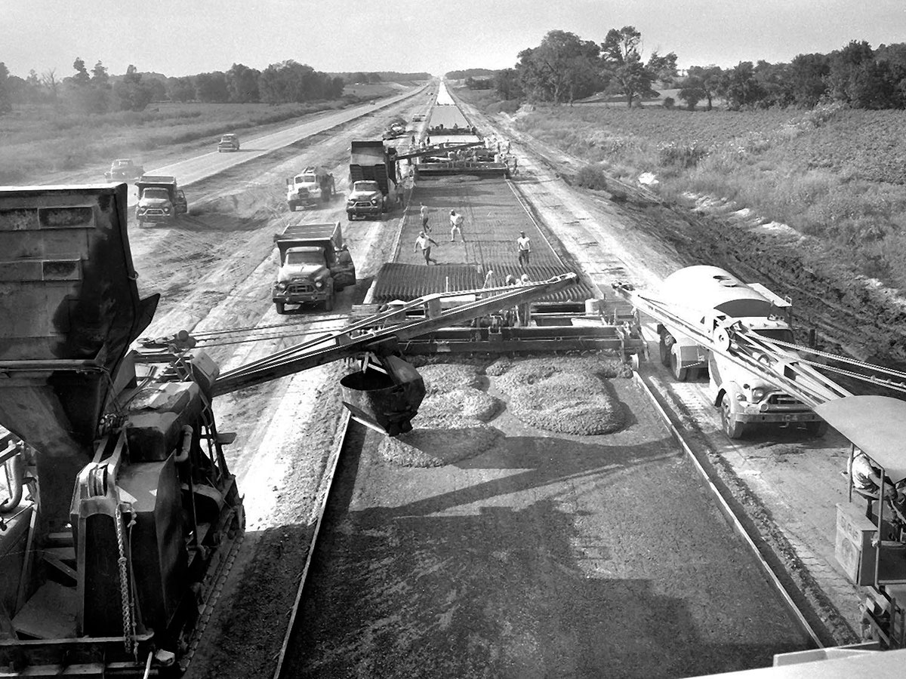
Notes:
In 1956 Congress enacted the Federal Highway act, essentially beginning the US Interstate Highway System

Slide 4
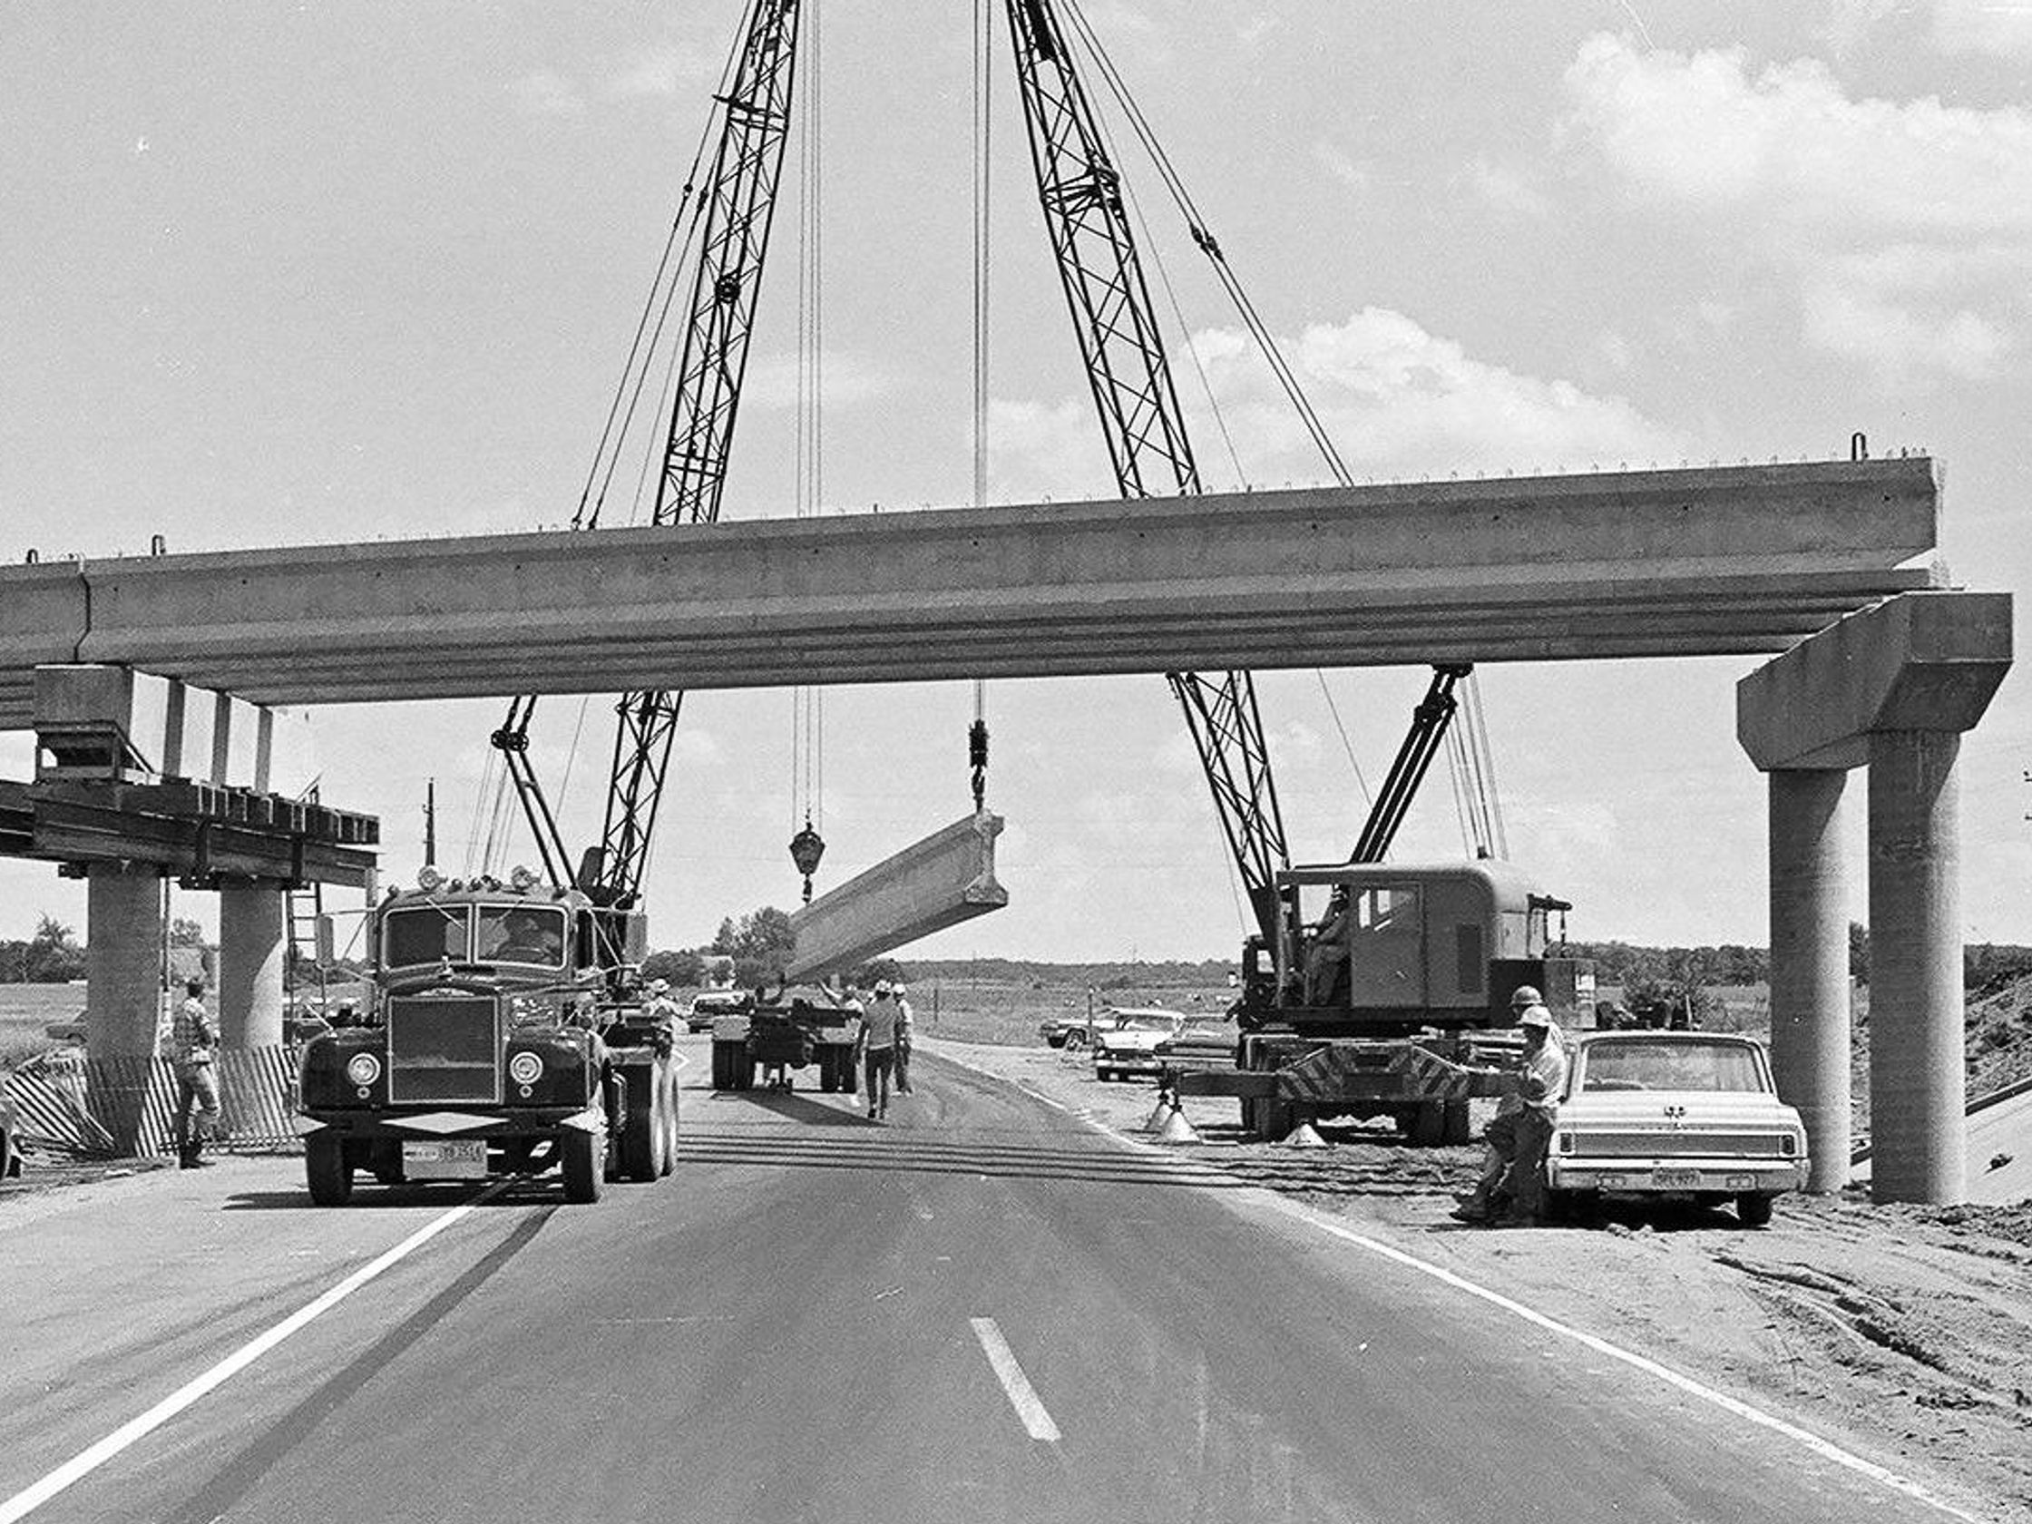
Notes:
Many of our nations bridges were constructed as a part of that effort

Slide 5
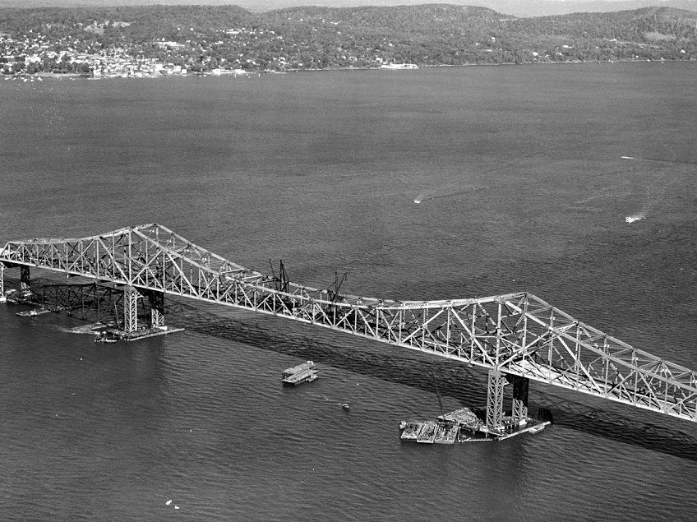
Notes:
Tappan Zee Bridge being completed in 1955

Slide 6
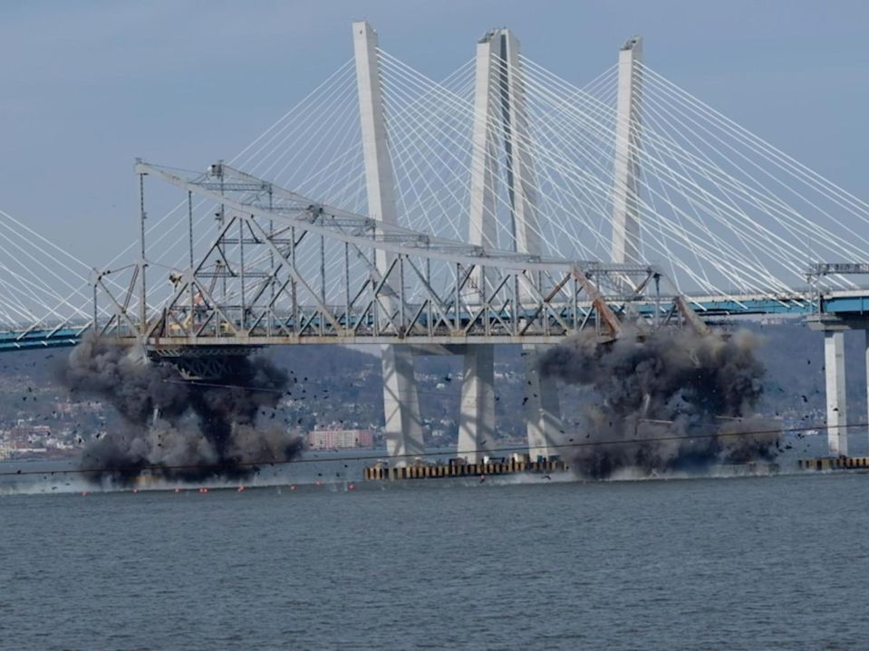
Notes:
Roughly 60 years later it, like many structures, reached the end of its service life, rendered obsolete by modern transportation demands.
However, while this structure was replaced with a shiny new bridge…

Slide 7
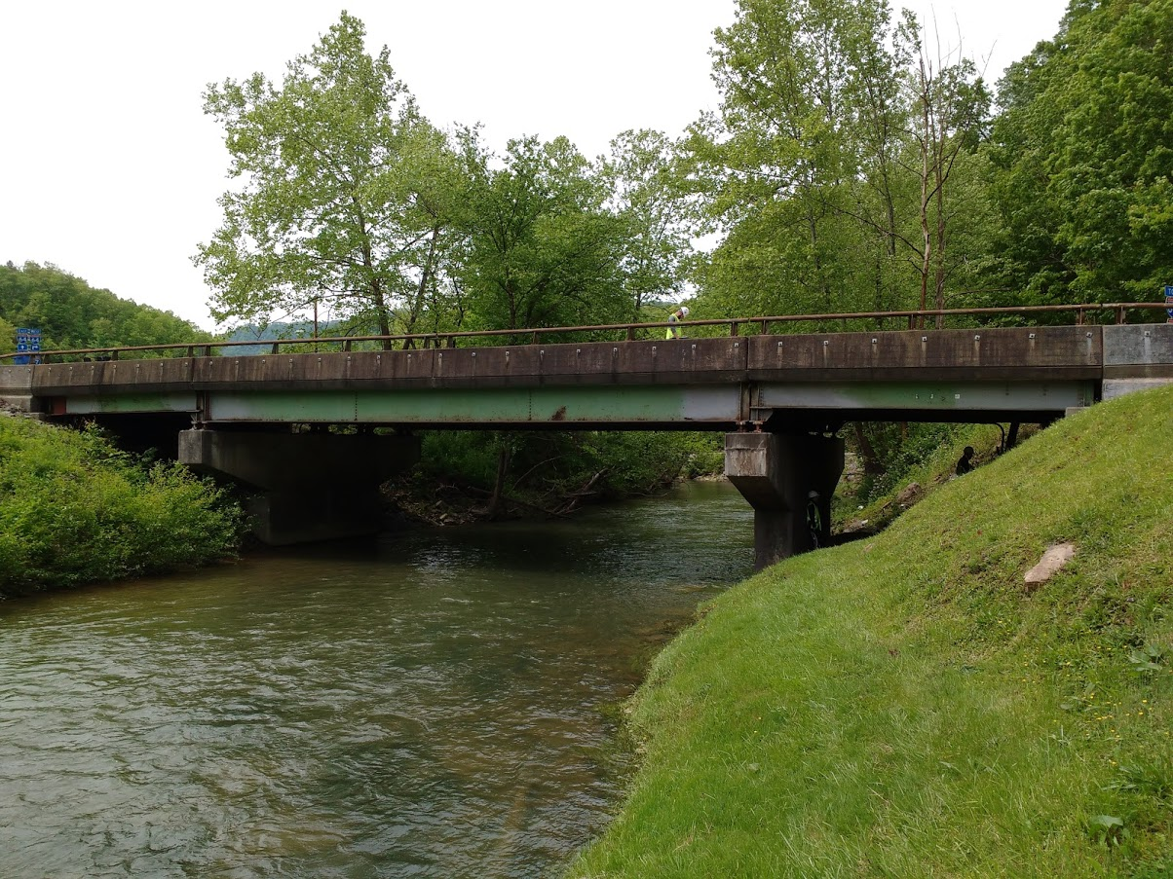
Notes:
There is limited funding, and smaller highway bridges cannot be replaced

Slide 8
Research Need
State of US Bridges *
Majority approaching or exceeding design life
$123 billion required
70 million projected population growth by 2045
40% increase in freight volume by 2045
Stewardship Objectives
Continued performance of existing bridges
Improved performance of new bridges
Informed resource allocation
Required Knowledge
Realistic demands
Factors affecting performance
Bridge deterioration
* 2017 ASCE Infrastructure Report Card
Beyond Traffic 2045
Notes:
Furthermore, the population continues to grow, and repair work becomes increasingly expensive.
Therefore, it is the objective (AND IMPERATIVE) of engineering practice to preserve infrastructure in an efficient manner.
While this will require a better understanding of many facets related to bridge performance, my research focused on examining the demands placed on bridges.

Slide 9
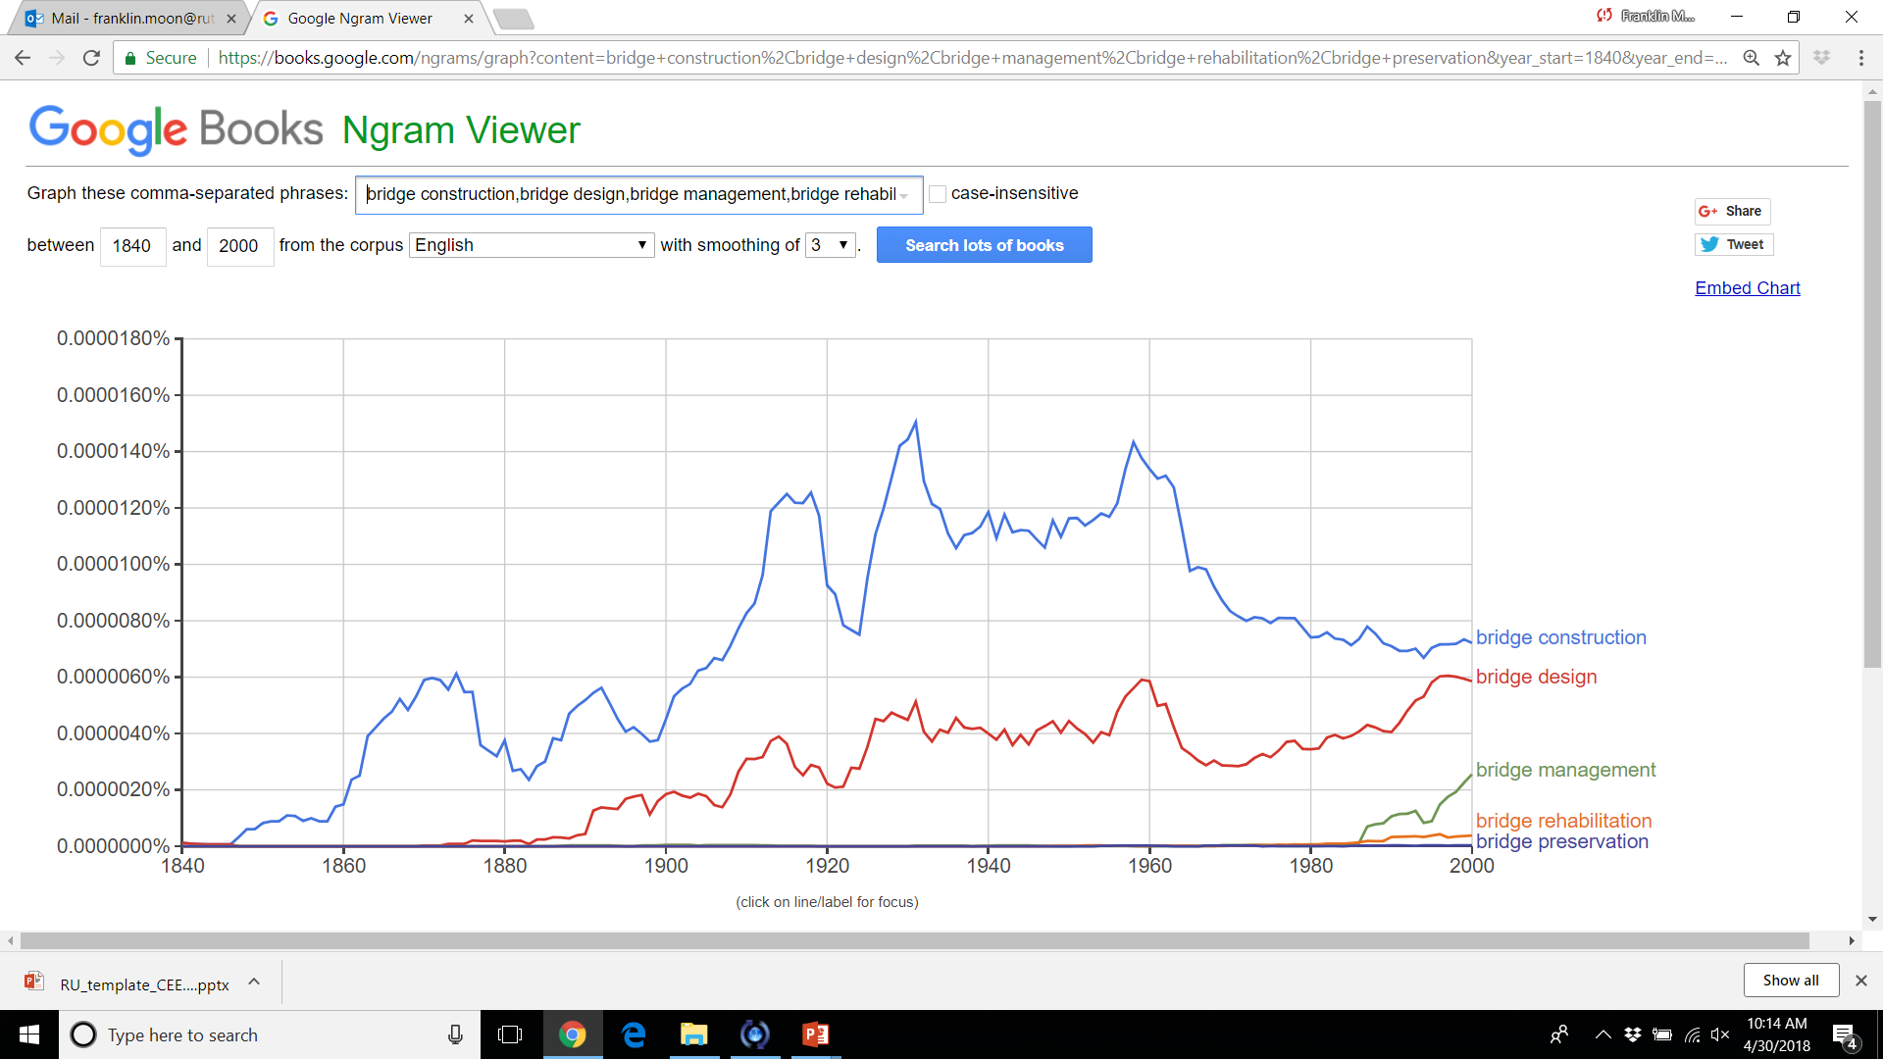
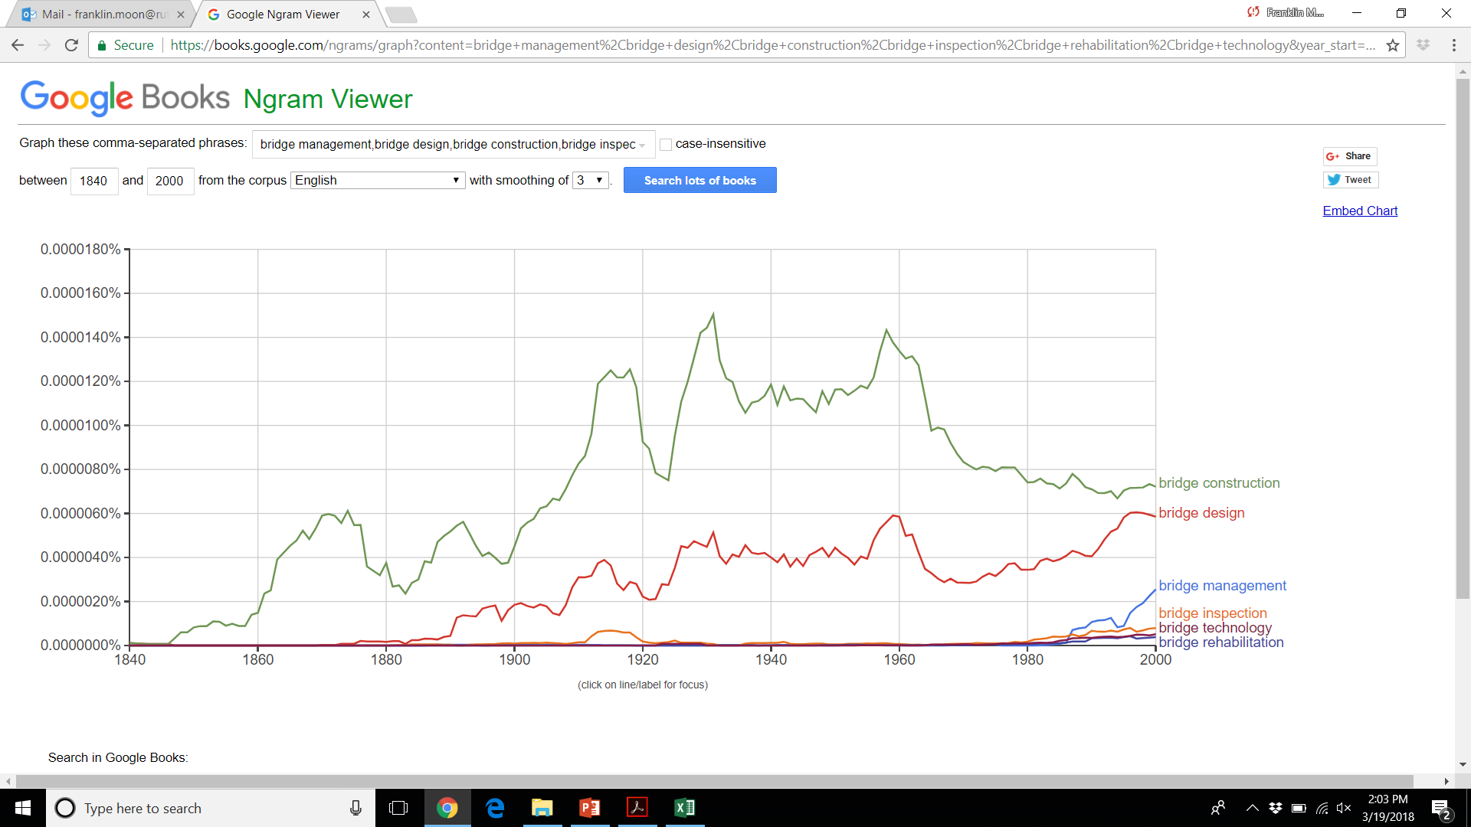
Usage of Bridge-Related Terms …as a surrogate for perceived importance, knowledge
Appearance of Bridge-Related Terms in Books Published in English 1840-2000
Pacific Railroad Act (1862)
Ford Model T Introduced (1908)
WWI (US)
Great Depression (1929)
Federal-Aid Highway Act (1956)
AASHTO LRFD Introduced (1994)
Bridge Construction
Bridge Design
Bridge Management
Bridge Rehabilitation
Bridge Preservation
Notes:
The knowledge gap in this area is not surprising. Advances in bridge practice has largely been reactionary, developing knowledge as required. Bridge preservation is a new paradigm that we must now address.

Slide 10
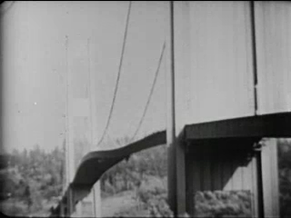
Notes:
In 1940 engineers learned the valuable lesson that bridge dynamics can present appreciable demands on the structure when the Tacoma Narrow Bridge collapsed in high winds.

Slide 11

Vehicle Loading
Live load demands principally consist of truck loads
Static analysis prescribed
Dynamic component reduced to “amplification” factor
Question: Is this simplification adequate?
VS
m
m
m
m
m
m
Notes:
So to do crossing vehicles excite bridge dynamics. However, typical highway bridges largely only consider the static effect of vehicle loads.
The dynamic interaction of vehicle and bridge is termed VBI.
Most design and evaluation codes account for VBI and bridge dynamics with an “amplification factor”.
The research I am presenting will be examining the phenomenon of VBI to determine if this simplification is still adequate.

Slide 12
Objectives
Establish the mechanisms that result in levels of VBI that render the common static live load model unconservative,
For the cases identified in (1) develop and validate a practical approach to estimating the effects of truck loads inclusive of VBI, and
Implement simulation tools to address challenges associated with VBI.
Notes:
Therefore, the objectives of my research are:
Gain a better understanding of VBI and dynamic amplification
Develop a more accurate and practical approach to quantifying the dynamic response.
Use gained knowledge and developed tools to generate useful knowledge and recommendations.
Difference from previous studies:
Field testing and model calibration will ensure the models are capable of simulating VBI
Influential parameters will be examined simultaneously
Practical simulation tool
Develop actionable conclusions

Slide 13

Dynamic Amplification Factors
Static loads used in highway bridge design and evaluation
Amplification factors to account for additional load effect from VBI applied to loading model
Two Definitions:
$IM=\frac{Dynamic Response−Static Response}{Static Response}$
$DAF=\frac{Dynamic Response}{Static Response}$
$LL=\left(1+IM\right)∗R_{sta}$ or $LL=DAF∗R_{sta}$
Notes:
A quick introduction to dynamic amplification factors as defined by codes

Slide 14
Dynamic Amplification in Codes
Different countries use different factors
Range from 0.05 to 0.40 (AASHTO: 0.33)
Dependent on:
road roughness, no. axles, 1st natural freq, span length
Developed through surveys of existing bridge stock in the 1950s and 1980s
More recent experimental evaluations of IM’s
High variability
Not uncommon to exceed prescribed value
Notes:
The methods for determining dynamic amplification vary from code to code. Some codes determine the amplification factors with equations that include variables such as span length, vehicle characteristics, and road roughness. Generally they do not exceed 0.4. AASHTO specifies a straight factor of 0.33.

Slide 15
State of Research Summary
Current methods are not accurate and not always conservative.
Inherent to the manner in which factors were developed
Demonstrated by field experiments (i.e. outliers)
Current state of research concludes VBI is too complicated to generalize.
Too many parameters (and complicated)
Interdependency of influential parameters has been largely overlooked
Simulation studies on influential parameters have failed to reach actionable conclusions
The impact of changes in the nature of truck loading on bridge dynamics and performance has not been addressed.
Heavier loads, truck platoons may pose a threat to bridge performance while conservatism is reduced
Notes:
Even the field experiments conducted for the establishing code specifications reported structures with high amplification.
Plural of anecdote is not evidence… Field experiments are limited to the population subset and only serve to demonstrate shortcomings, rather than propose improvements
Research on the subject consistently concludes that the factors affecting dynamic amplification are too numerous and too complex to make generalized conclusions.
Simulations have been mostly with simplified models (i.e. single-line girder),
and with only a few parameters to be investigated
and no assurance that the models are capable of simulating VBI
The effect of repeated loading on bridge dynamics has only be addressed for railway bridges, which experience very different loading scenarios than do highway bridges.

Slide 16
Inductive Research Strategy
Demonstrate Comprehensive Understanding of VBI
Phase 1 – Identify and characterize “test” structure through field testing. Develop FE models.
Phase 2 – Perform detailed characterization of VBI on test structure. Refine FE model.
Phase 4 – Identify methods for estimating and predicting dynamic amplification
Phase 5 – Investigate VBI mechanisms with sensitivity analysis of FE model parameters
Phase 6 – Leverage VBI simulation tools to address some of the challenges facing bridges associated with dynamic response.
Develop Practical Tools & Actionable Knowledge of VBI
Notes:
In order to achieve the objectives set forth and provide new and actionable knowledge on VBI, the research took an inductive approach
Whereby a “test” structure that was experiencing large vibrations was investigated and characterized through operational monitoring.
By characterizing the vehicle-bridge interaction experienced by this structure, I could be confident in the tools and methods for simulating the interaction.
Only once this confidence was established could analytical tools be leveraged to develop useful tools and conclusions.

Slide 17
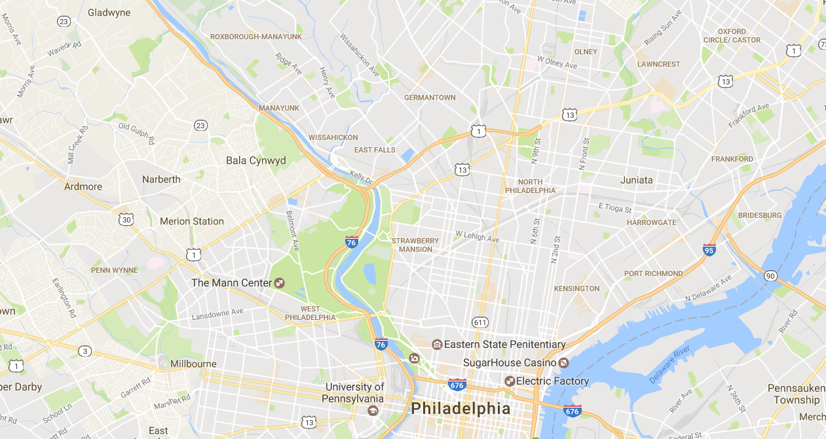
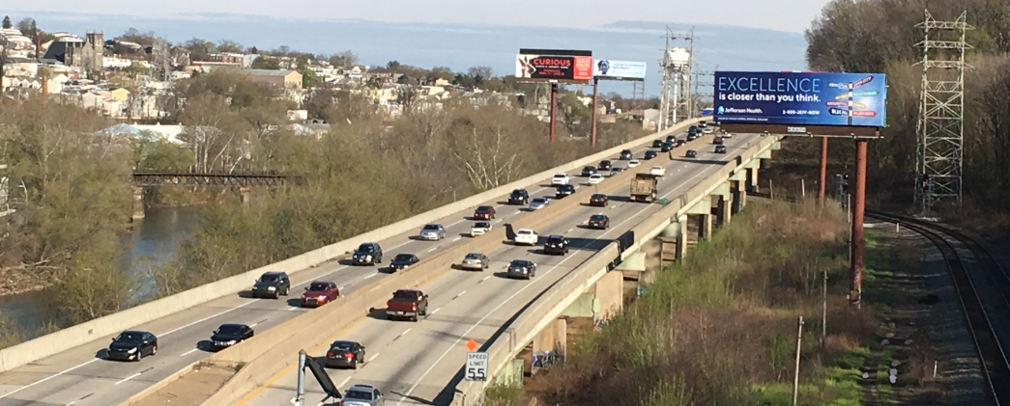
Introduction to Test Structure
Notes:
The case structure was an 11-span viaduct.
It carries 4 lanes of traffic (I76) just outside of Philadephia

Slide 18
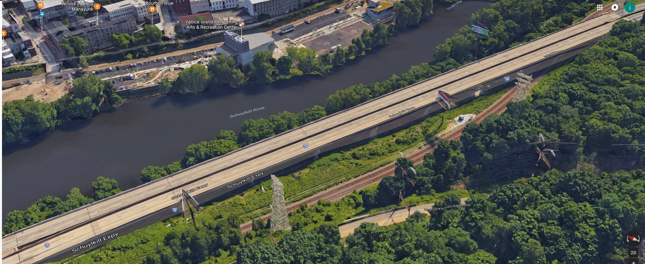
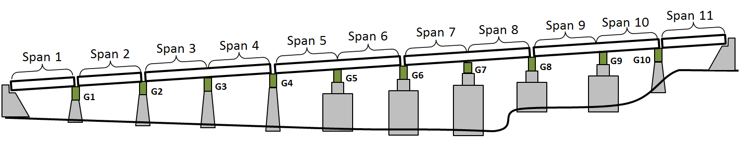
Introduction to Test Structure
Span 10
Span 8
Span 9
Span 6
Span 7
Span 4
Span 5
WESTBOUND
Span 2
Span 3
EASTBOUND
Span 1
Notes:
The original structure was built in 1952
It was rebuilt 1986 with a new superstructure while reusing the concrete piers.

Slide 19
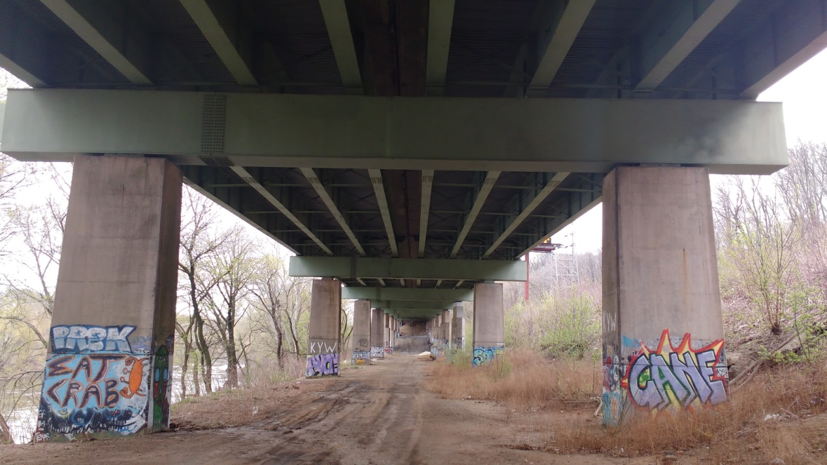
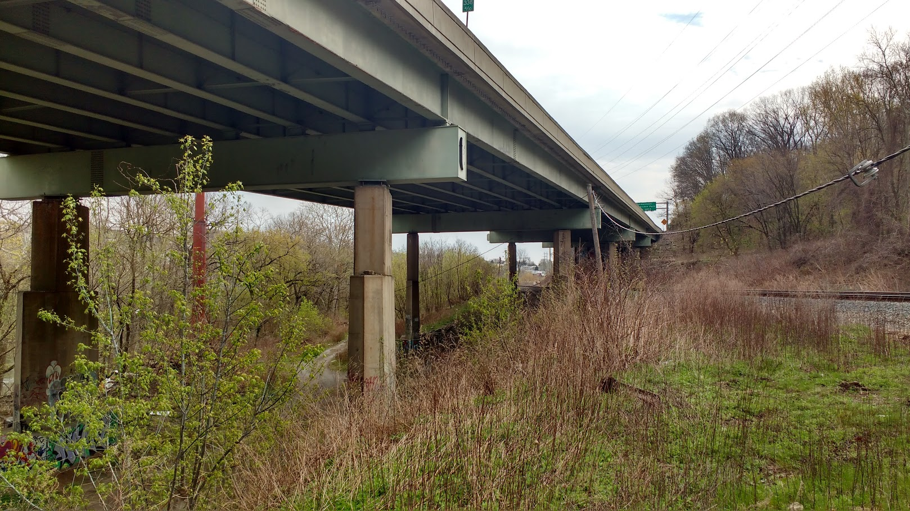
Introduction to Test Structure
Notes:
The structure features (8) plate girders that are ~6ft deep.
They are supported by steel box girders.

Slide 20
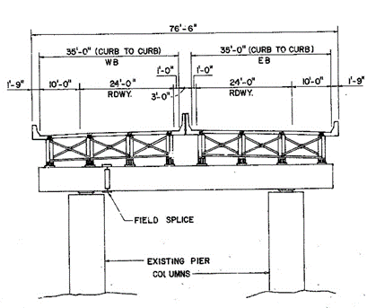
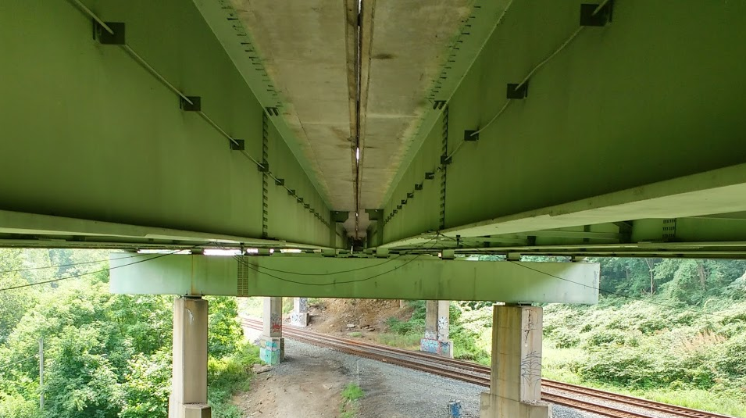
Introduction to Test Structure
Notes:
The deck is separated between the center 2 girders, effectively resulting in 2 adjacent bridges.

Slide 21
Experimental Approach
Phase 1 – Quantify the levels and spatial variation of vibration
Phase 2 – Detailed characterization of structure by monitoring operational responses
Phase 3 – Development and calibration of an FE model
Phase 4 – Synchronized bridge/vehicle monitoring
Vehicle System
Interface
Bridge System
Direct measurement of bridge profile
Phase 5 – Simulation of bridge/vehicle interaction
Notes:
The goal of the field testing was to characterize the vehicle-bridge interaction.
This was performed in a crawl-walk-run sequence, whereby the structure was incrementally investigated.
The first phase of testing was performed to just determine what regions of the structure were experiencing large vibrations.

Slide 22
Phase 1 Testing: Objectives
Primary Goal:
Identify which portions of the structure were experiencing the greatest vibration and should receive further testing.
Objectives:
Locate those spans which experience the largest vibrations
Identify in which direction the largest vibrations are occurring

Slide 23
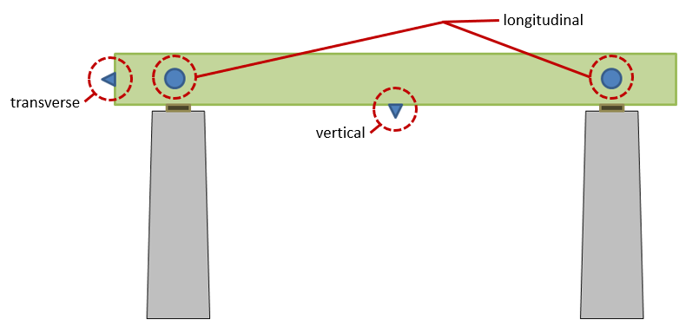
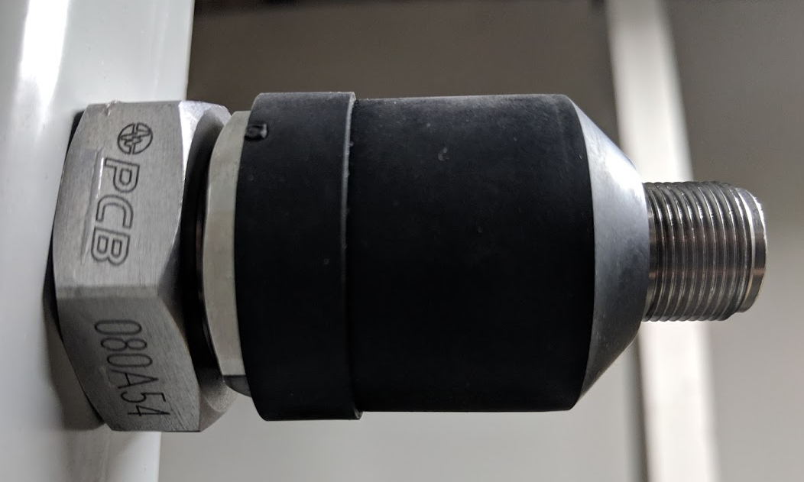
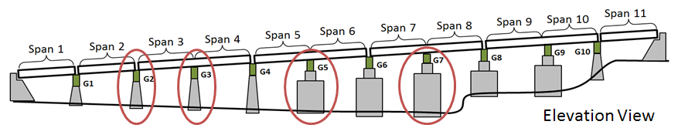
Phase 1 Testing: Instrumentation Plan
Notes:
Therefore, accelerometers were used to instrument the bridge at various locations.
Accelerometers were chosen because they could be quickly deployed, and were best suited to recording vibrations.
4 locations were chosen for instrumentation.
At each location accelerometers were placed to capture vertical, transverse, and longitudinal motion of the cross-girder.
The accelerometers were affixed to the cross-girder with magnetic bases.

Slide 24
Phase 1 Testing: Results
Notes:
The results from this phase of testing revealed that similar levels of vibration were being experienced at all locations.
Spans 7 and 8 were chosen for further monitoring.
Other factors for deciding future instrumentation included accessibility, and the idea that the viaduct was more flexible where supported by tall piers.

Slide 25
Experimental Approach
Phase 1 – Quantify the levels and spatial variation of vibration
Phase 2 – Detailed characterization of structure by monitoring operational responses
Phase 3 – Development and calibration of an FE model
Phase 4 – Synchronized bridge/vehicle monitoring
Vehicle System
Interface
Bridge System
Direct measurement of bridge profile
Phase 5 – Simulation of bridge/vehicle interaction
Notes:
This 2nd phase was intended to provide more detailed characterization of the structure’s vibration.

Slide 26
Phase 2 Testing: Objectives
Primary Goals:
Characterize the superstructure and quantify the operational dynamic amplification.
Objectives:
Identify the superstructure’s global (operational) modes of vibration.
Capture operational vibrations and strains at critical locations and locations of maximum response

Slide 27
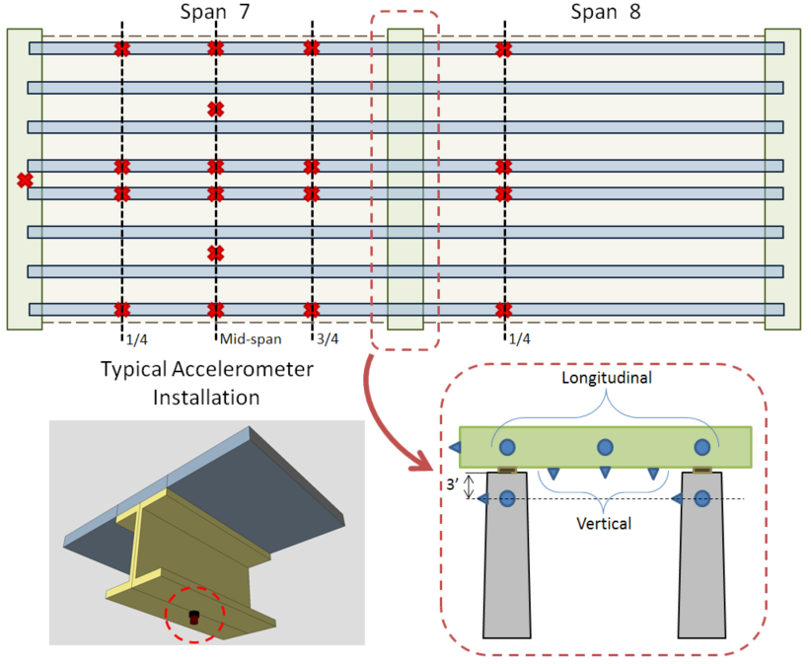
Phase 2 Testing: Accel Instrumentation Plan
Notes:
Accelerometers were positioned to capture global modes of vibration.
The layout appears anti-symmetrical. This is because a utility line prevented access to most of Span 8.
However, the few sensors on span 8 would be enough to determine the direction of motion of the span relative to span 7,
allowing similar mode shapes to be distinguished.

Slide 28
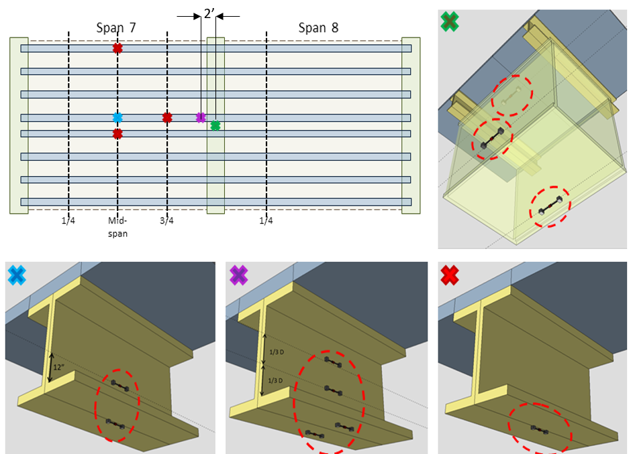
Phase 2 Testing: Strain Instrumentation Plan
Notes:
Strain gauges were positioned to capture the maximum (stress inducing) deformation of the structure.
Multiple gauges were placed at each location so the strain profile may be determined.

Slide 29
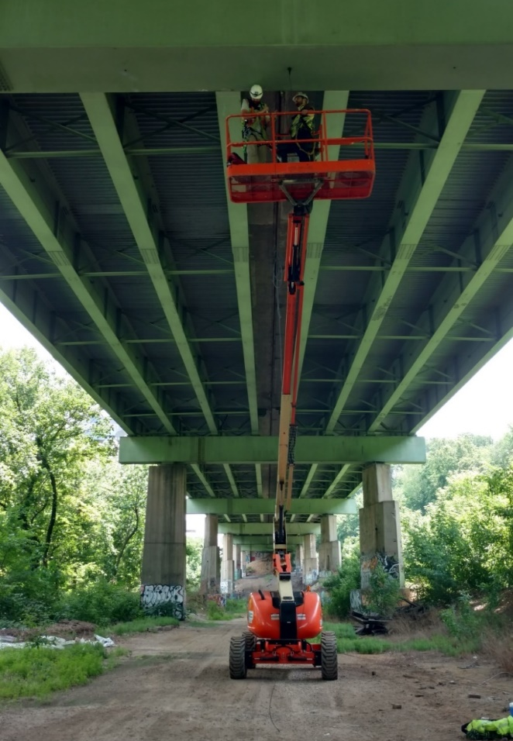
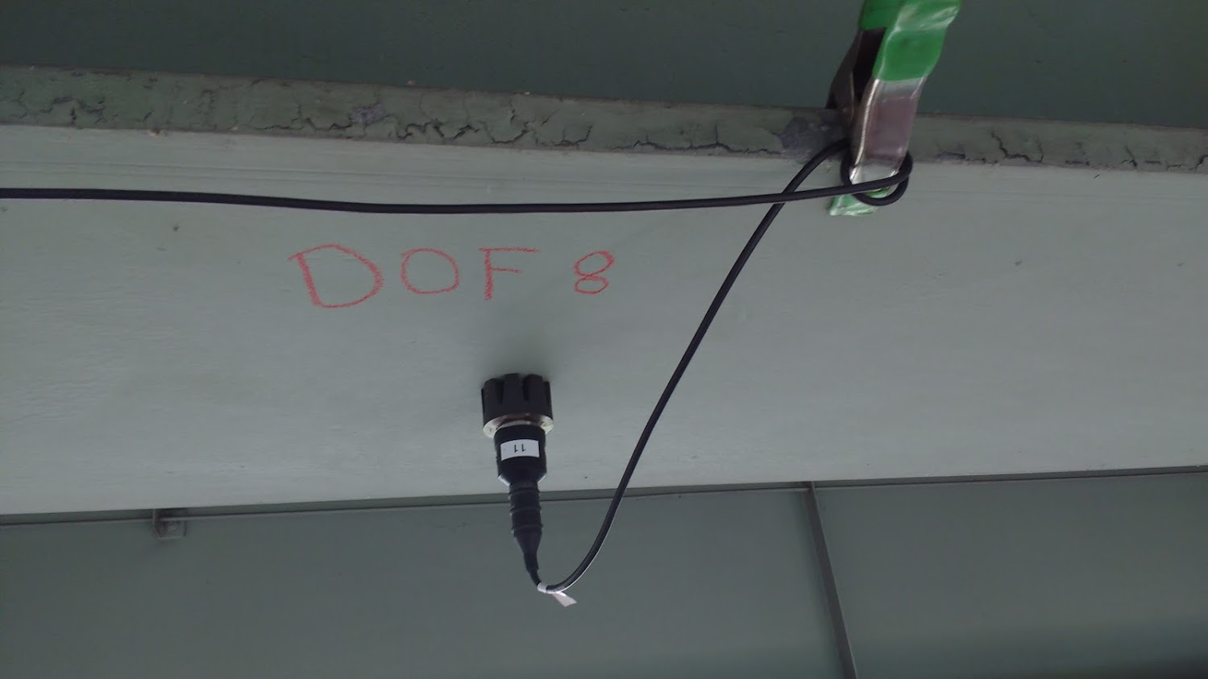
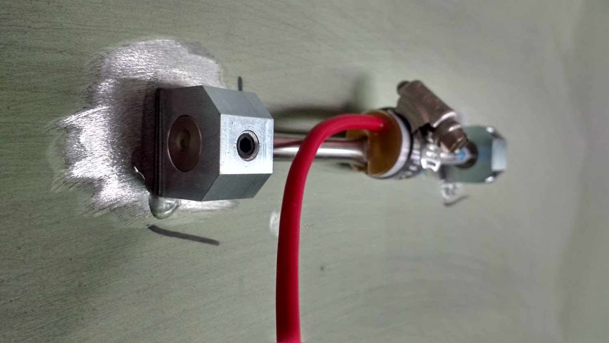
Phase 2 Testing: Test Activities
Notes:
Access was provided with a boom lift.
Accels were attached with magnetic bases.
Strain gauges were attached with epoxy.
It took 2 days to install the 30 accelerometers and 12 strain gauges
Data was recorded for more than 14 hours.

Slide 30
Phase 2 Testing Results: Strain Time History
Notes:
The recorded strain revealed frequent high-strain events.
Strain… more direct measure of what the material is experiencing (which is the basis for nearly all performance metrics).
200 microstrain – 6 ksi

Slide 31
Phase 2 Testing Results: Strain Amplification by Filtering
Notes:
One event is zoomed in on.
An Elliptic filter with 1.5 Hz cutoff frequency was applied to estimate dynamic amplification.
This process attempts to estimate the static response by removing the dynamic component by filtering out frequency content associated with the structure’s vibration
For this event, the apparent DAF is near 2.0.

Slide 32

Phase 2 Testing Results: Modal Parameter Identification
CPSD
SVD
ψ_{f}
Cross Power Spectral Density
$$\left.H_{f}=\left[ψ\right]∗\left[Λ\right]∗[L\right]$$
Locate peaks in singular values
Evaluate ψ at largest singular value
Notes:
To characterize the structure, acceleration data was processed to obtain the mode shapes and frequencies of the bridge.
This was done using the popular CMIF function, which consists of 3 main steps.
Perform CPSD for all channels (to obtain square FRF matrix)
SVD to decompose into mode shapes (mode shape, singular values (i.e. rank, modal scaling), input (unknown, unused)).
Identify frequencies from singular value maxima
Mode shapes from left singular vector

Slide 33
Phase 2 Testing Results: Modal Parameter Identification
Notes:
Using this method, the singular values are obtained and plotted.
The peaks in the singular values correspond to frequencies of resonance and therefore assumed to be natural frequencies of the structure.
Peaks were manually identified/selected.
The left singular vector was subsequently sampled at the peak frequencies to obtain the mode shapes.

Slide 34
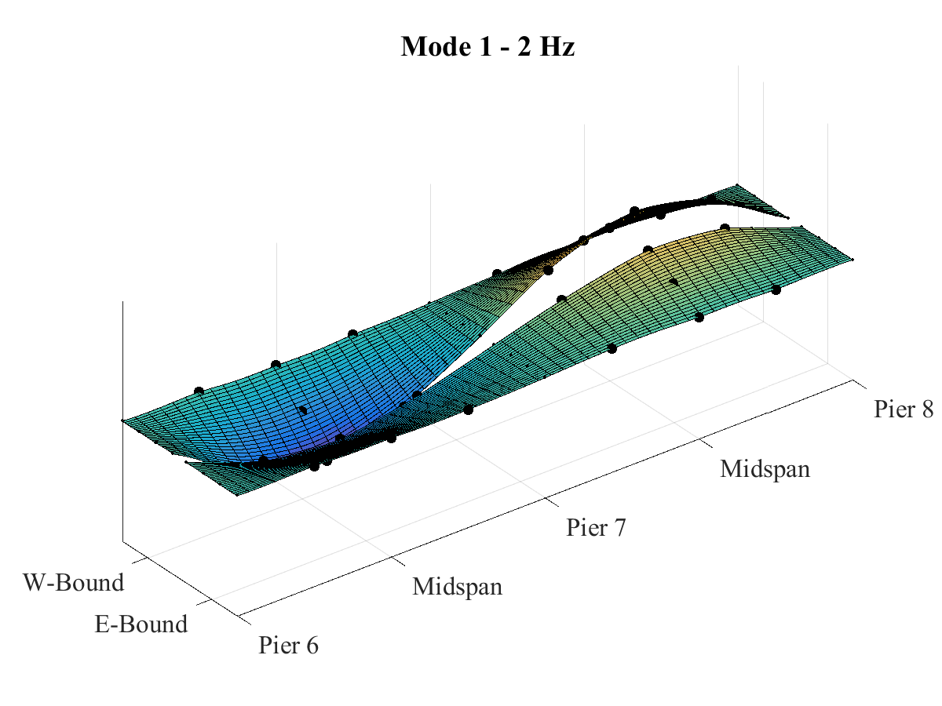
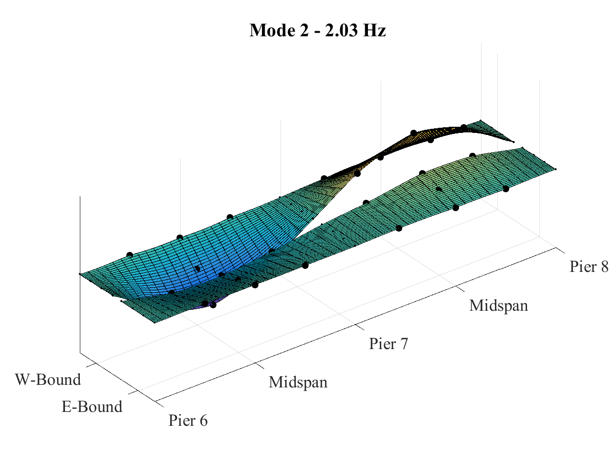
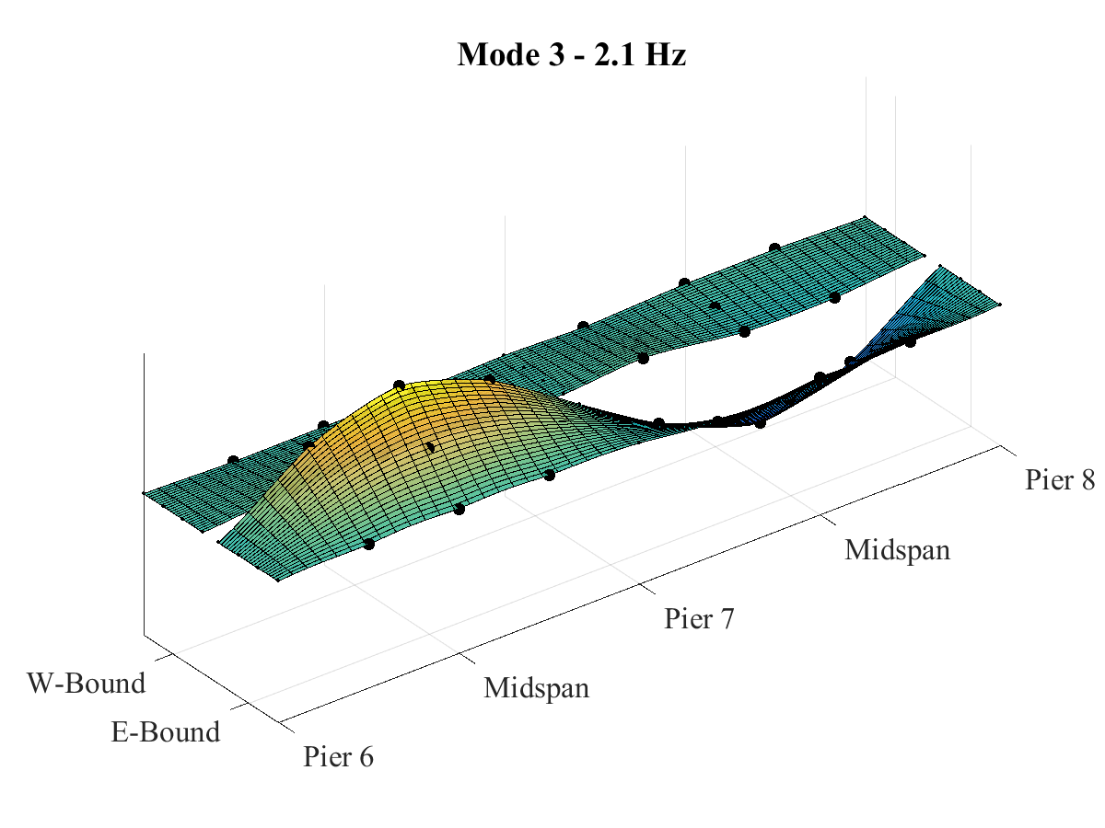
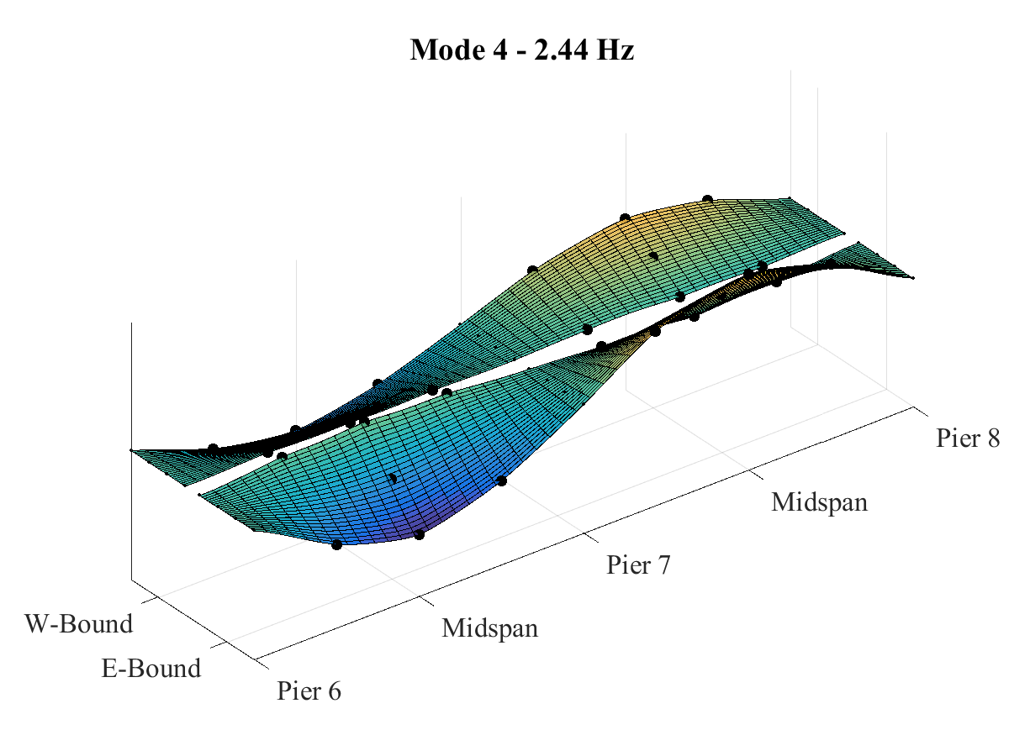
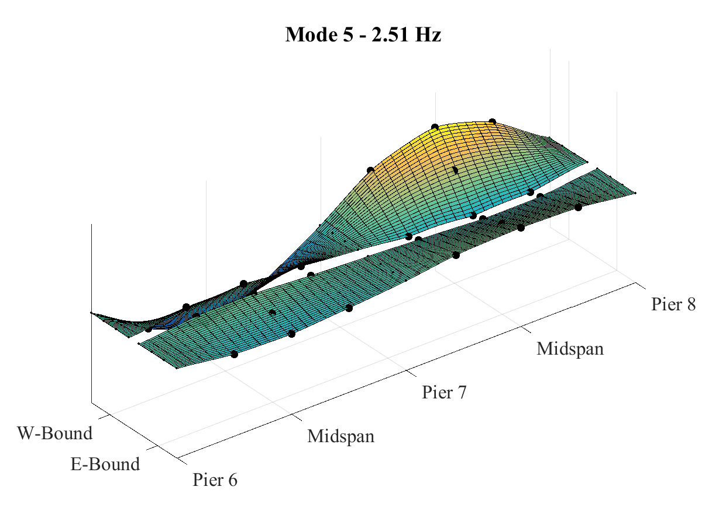
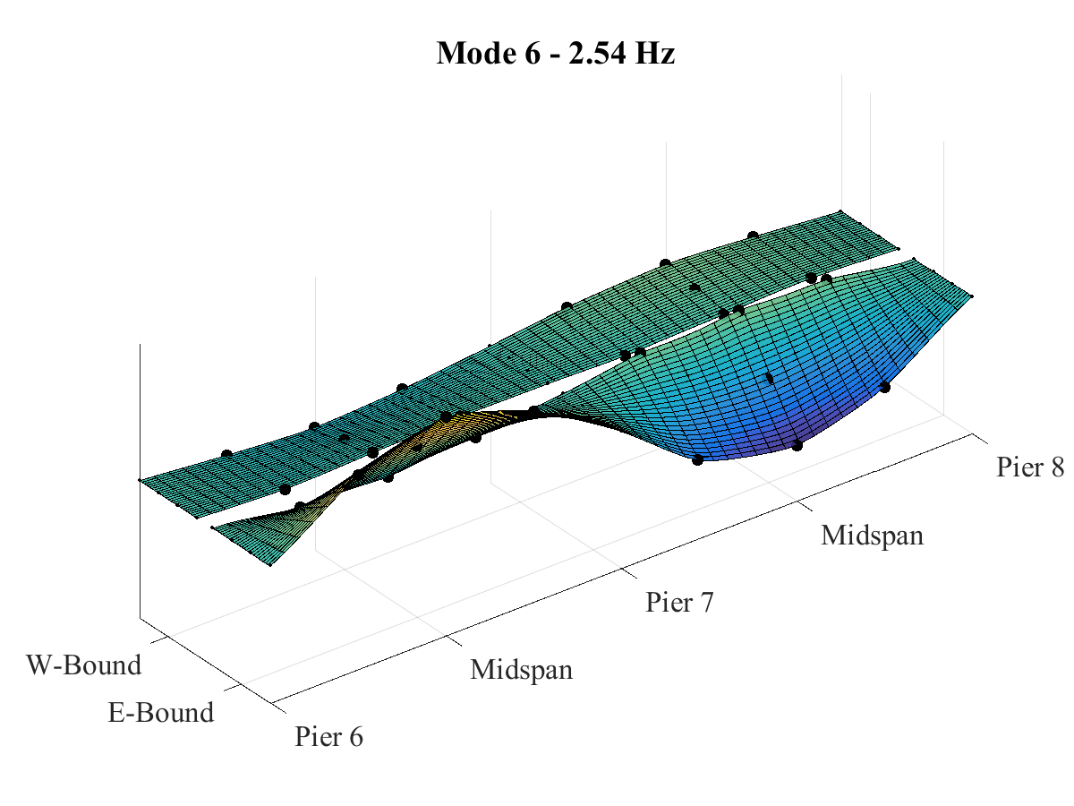
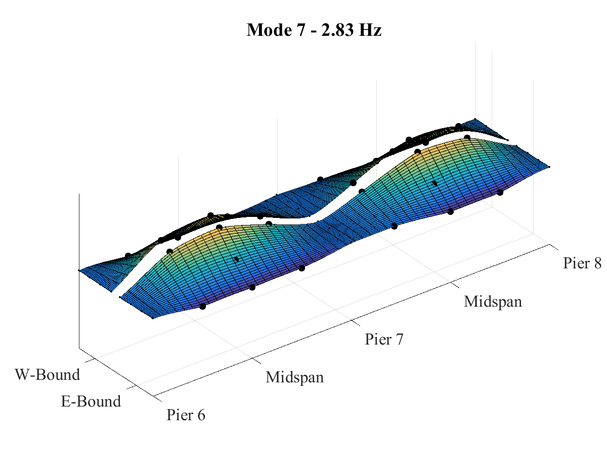
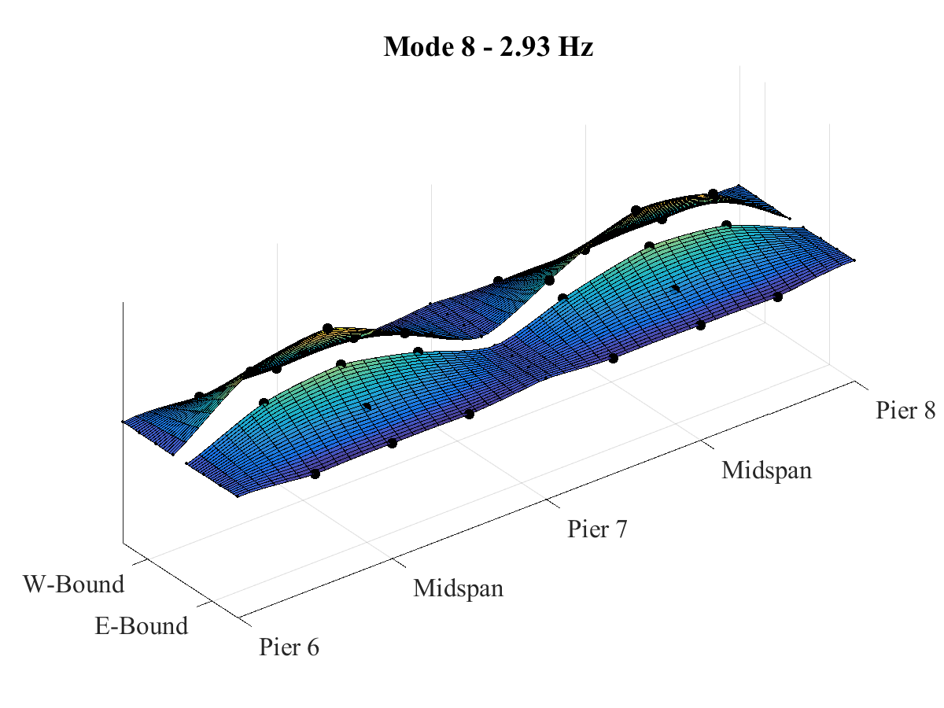
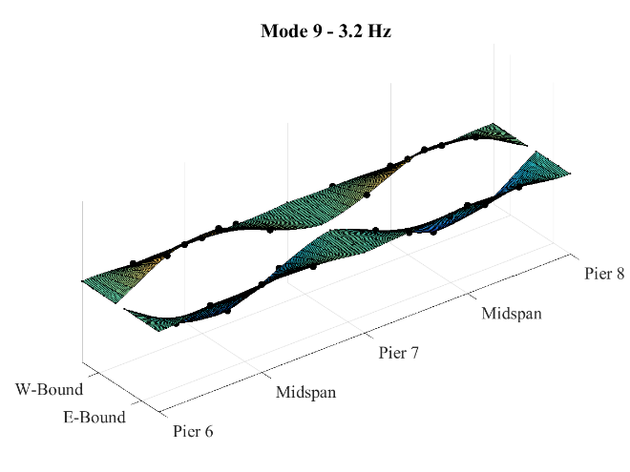
Phase 2 Testing Results: Modal Parameter Identification
Notes:
The nature of this structure results in several similar and closely spaced modes.

Slide 35
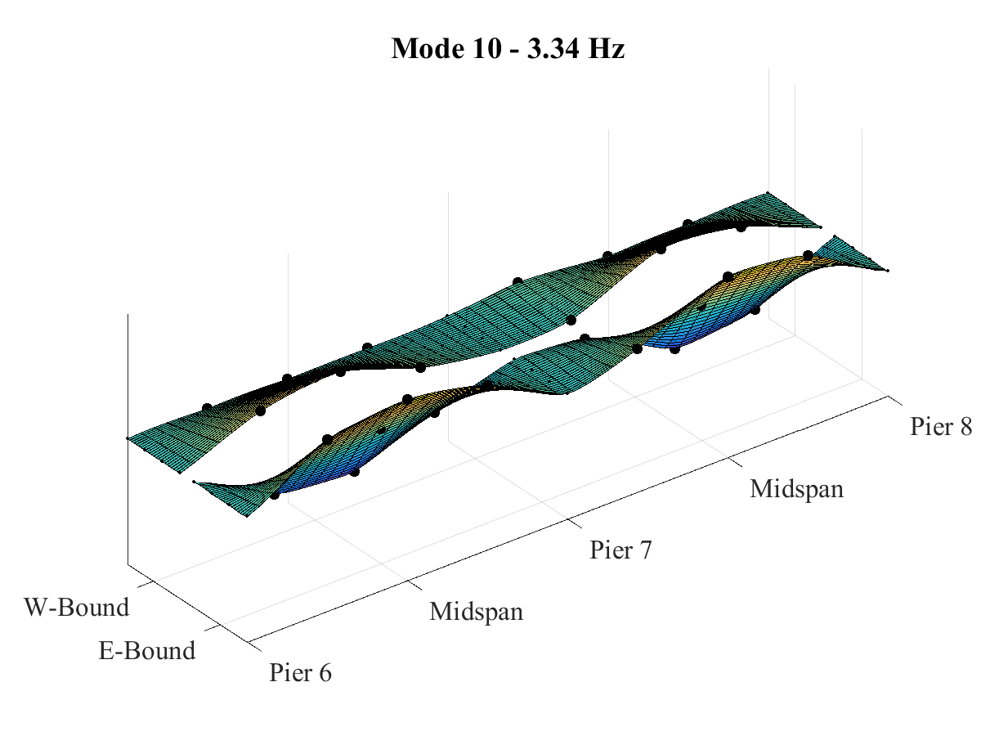
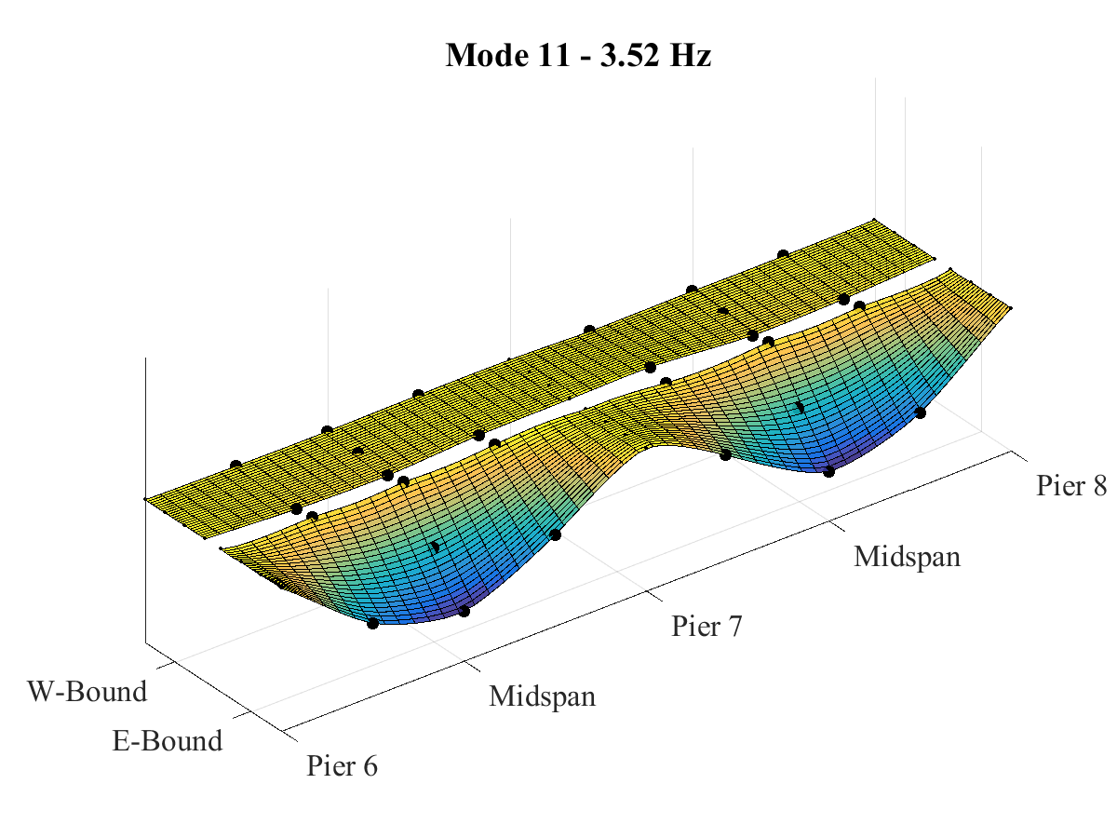
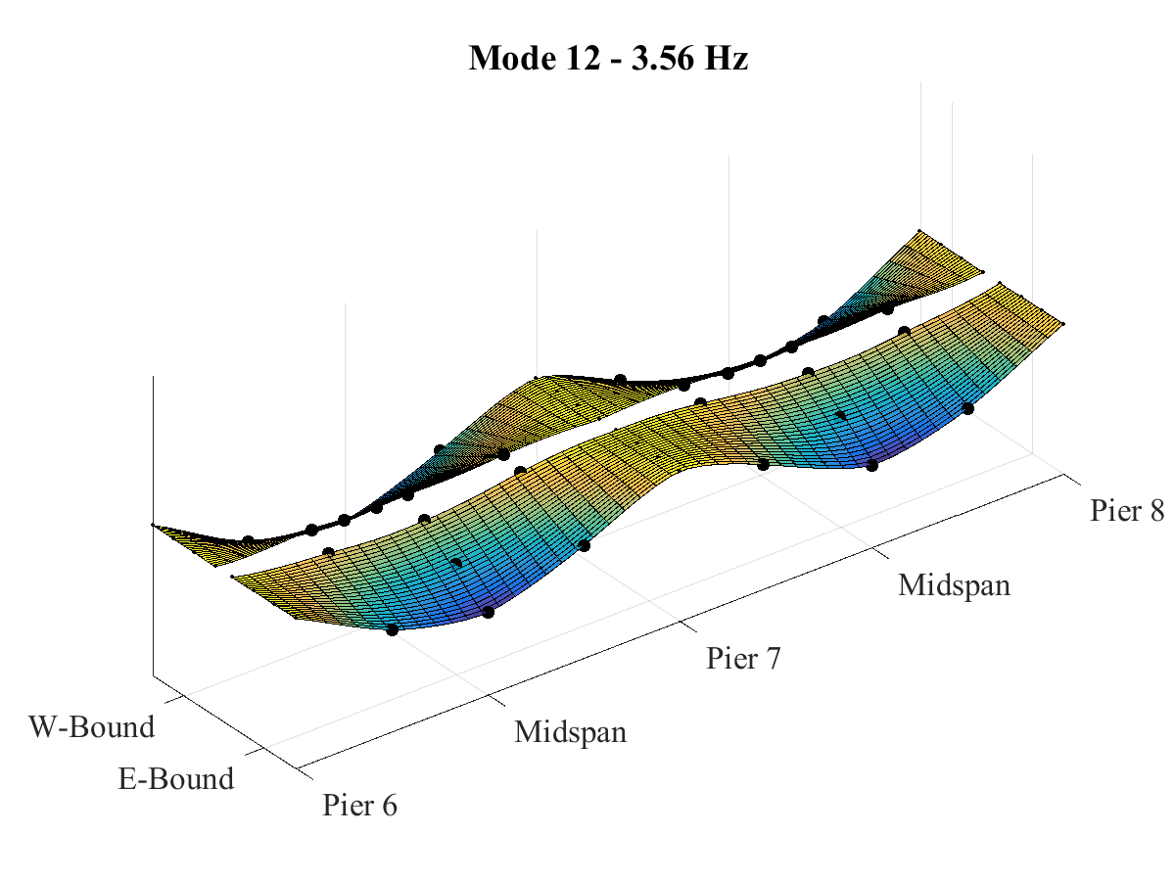
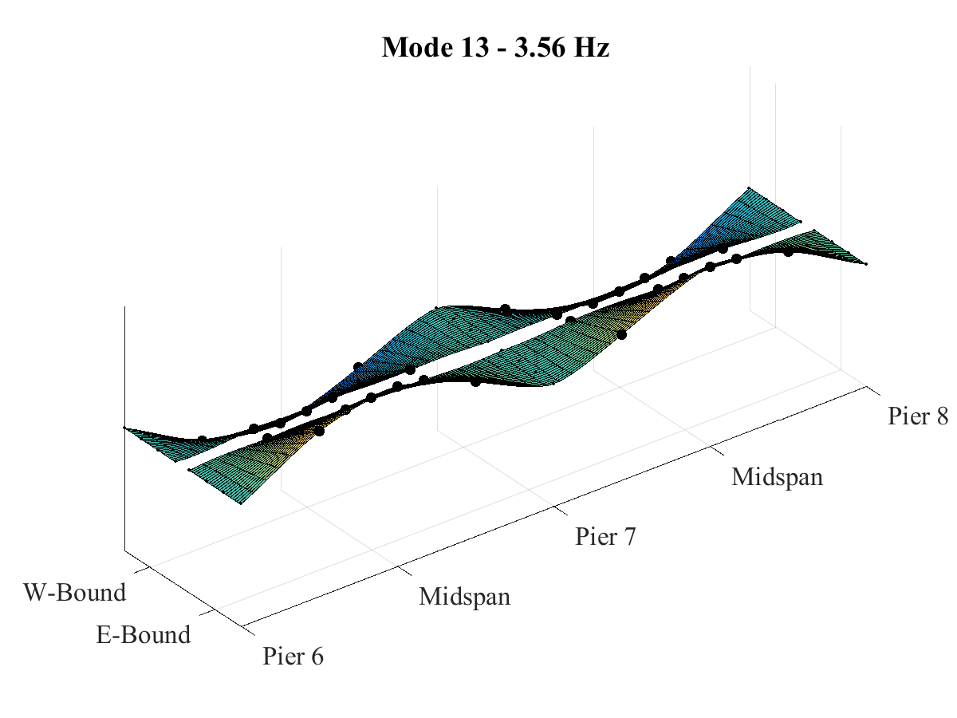
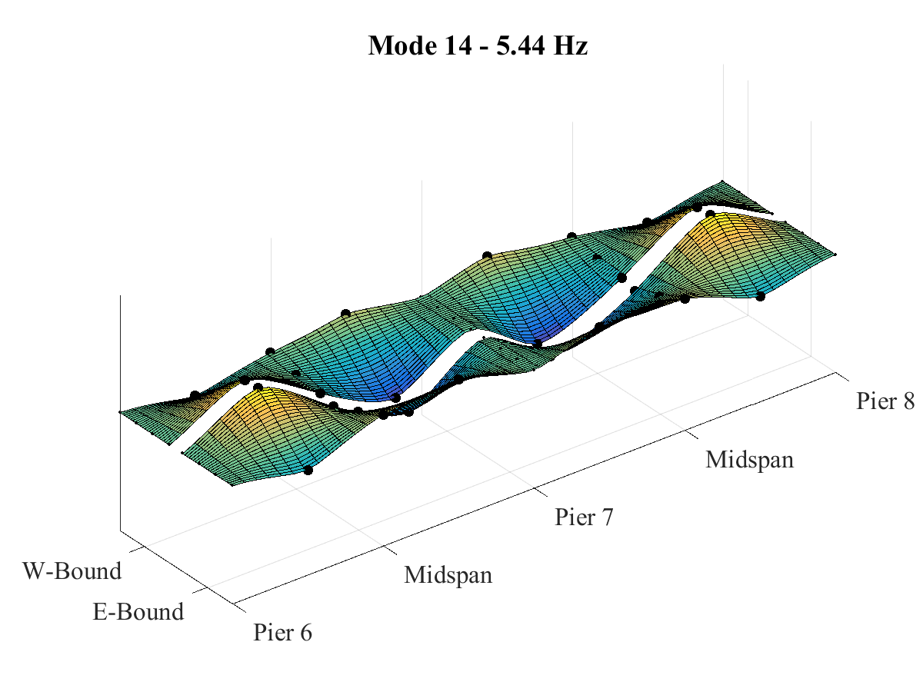
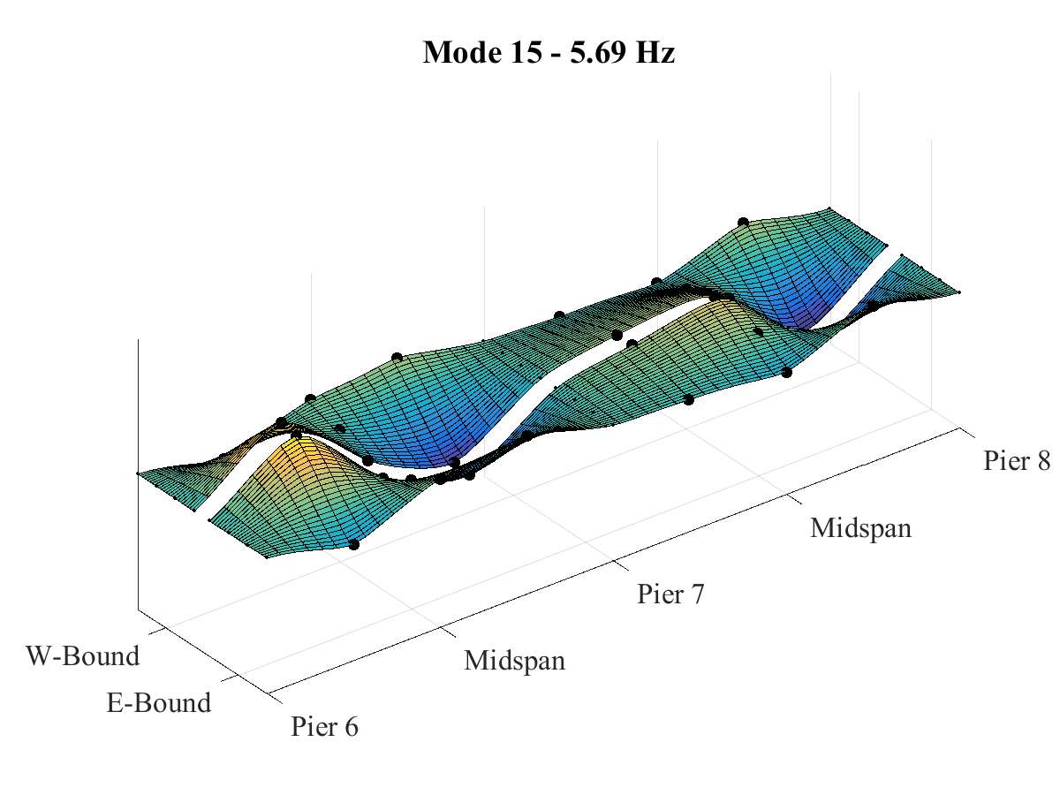
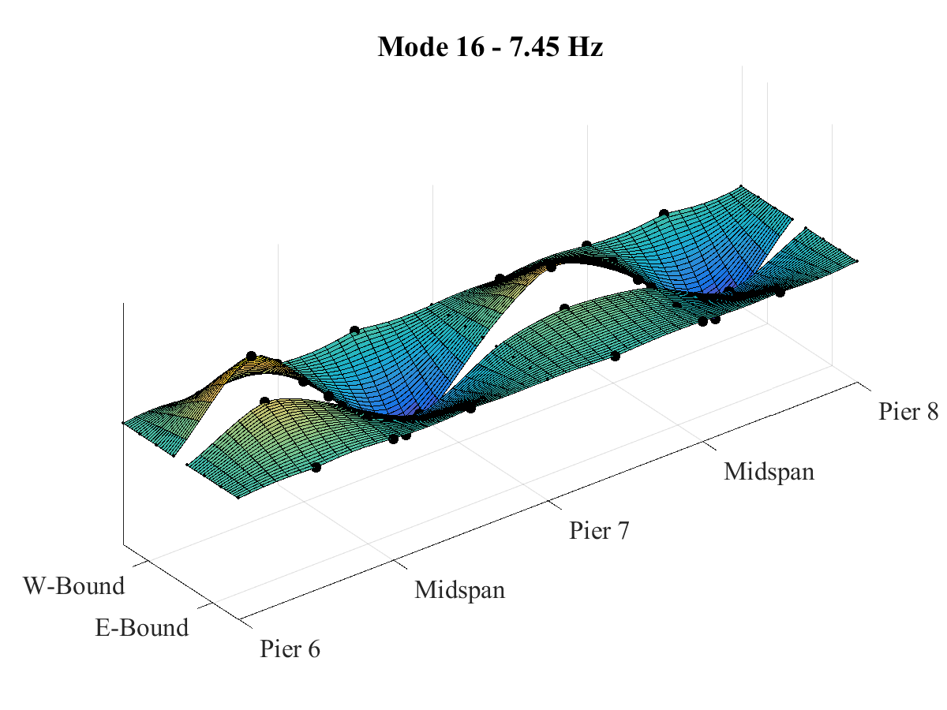
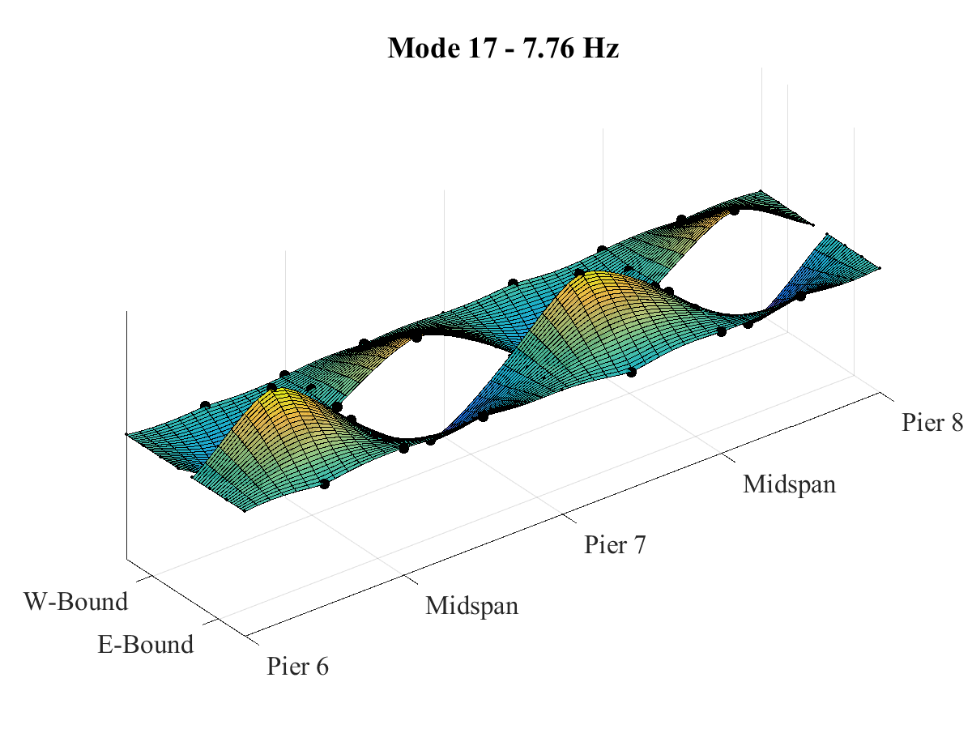
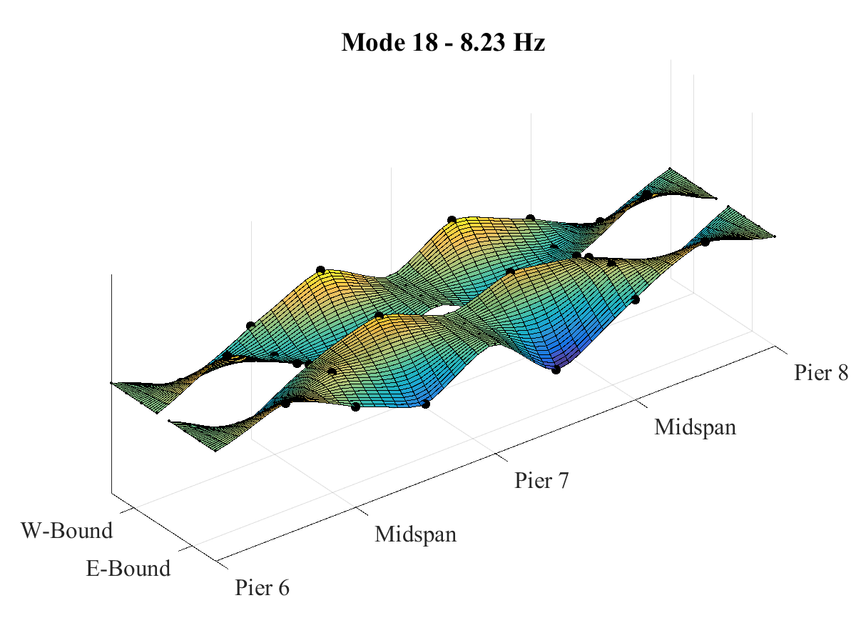
Phase 2 Testing Results: Modal Parameter Identification

Slide 36
Experimental Approach
Phase 1 – Quantify the levels and spatial variation of vibration
Phase 2 – Detailed characterization of structure by monitoring operational responses
Phase 3 – Development and calibration of an FE model
Phase 4 – Synchronized bridge/vehicle monitoring
Vehicle System
Interface
Bridge System
Direct measurement of bridge profile
Phase 5 – Simulation of bridge/vehicle interaction
Notes:
While phase 2 provided knowledge of the operational response of the structure,
it would require development of a FE model to characterize the physical mechanisms of the structure

Slide 37
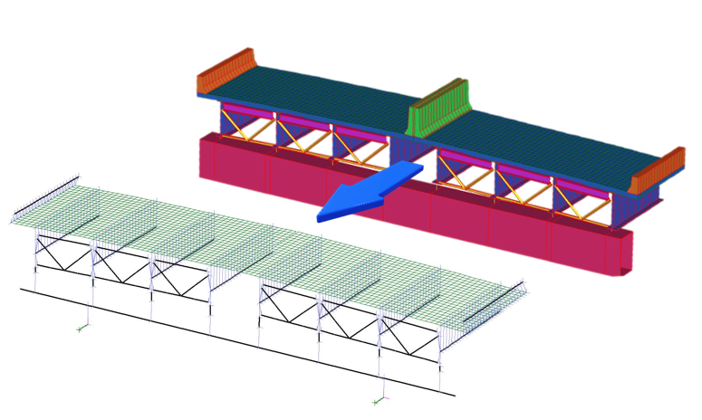
FE Modeling of Test Structure
Notes:
This was accomplished by creating an element-level 3D FE model.

Slide 38
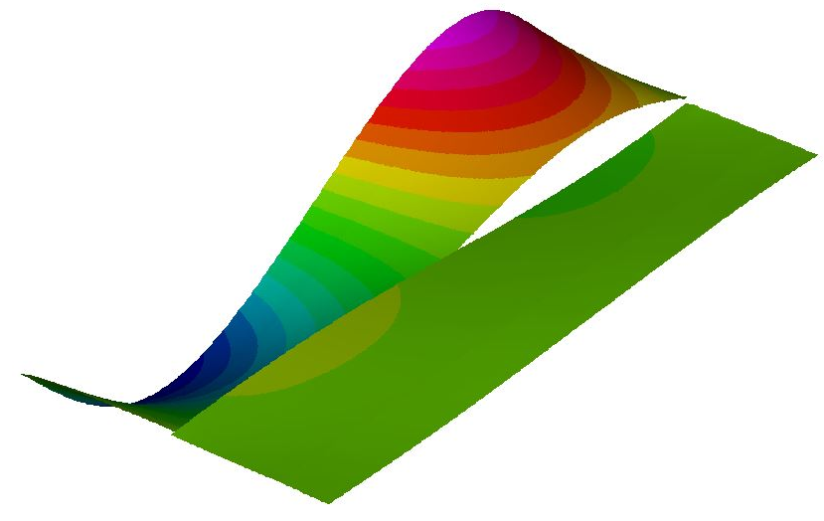
Phase 2 Testing Results: Model Calibration
 | Initial Values | Calibrated Values | units
Stiffness of interior barriers (modulus of elasticity) | 3982736 | 5 | lb/in²
Material density of interior barriers | 0.086705 | 0.104047 | lb/in³
Material density of exterior barriers | 0.086705 | 0.104047 | lb/in³
Elastomeric bearing lateral stiffness | 1.00E+09 | 4.00E+05 | lb/in
Continuity of exterior barriers over continuous support
Notes:
The model was calibrated by manually adjusting uncertain and influential parameters until the model’s predicted natural frequencies matched those obtained experimentally.
For instance, the preliminary model incorrectly predicted the first mode would consist of nearly symmetrical first bending.
In contrast, the experimental data revealed a torsional first mode, whereby the interior of the bridge experience much greater deformation.
Therefore, parameters were targeted that would effect the mass and stiffness of components in that area:
Barrier parameters

Slide 39
Phase 2 Testing Results: Model Calibration
 | Exp. | Prelim. FEM | % diff | FEM (cal.) | % diff
Mode 1 | 2.00 | 2.73 | 36.5% | 2.00 | <0.1%
Mode 2 | 2.03 | 2.37 | 16.7% | - | -
Mode 3 | 2.10 | 3.22 | 53.3% | 2.02 | -3.8%
Mode 4 | 2.44 | - | - | 2.28 | -6.6%
Mode 5 | 2.51 | - | - | - | -
Mode 6 | 2.54 | 3.77 | 48.4% | 2.33 | -8.3%
Mode 7 | 2.83 | 3.71 | 31.1% | 3.06 | 8.1%
Mode 8 | 2.93 | - | - | - | -
Mode 9 | 3.20 | - | - | 3.17 | -0.9%
Mode 10 | 3.34 | 4.58 | 37.1% | - | -
Mode 11 | 3.52 | - | - | - | -
Mode 12 | 3.56 | 4.25 | 19.4% | 3.68 | 3.4%
Mode 13 | 3.56 | - | - | 3.68 | 3.4%
Notes:
Good agreement was achieved with relatively few adjustments to the model.

Slide 40
Experimental Approach
Phase 1 – Quantify the levels and spatial variation of vibration
Phase 2 – Detailed characterization of structure by monitoring operational responses
Phase 3 – Development and calibration of an FE model
Phase 4 – Synchronized bridge/vehicle monitoring
Vehicle System
Interface
Bridge System
Direct measurement of bridge profile
Phase 5 – Simulation of bridge/vehicle interaction
Notes:
At this stage, no “smoking gun” could be identified.
All the model parameters were within reasonable bounds, so the vibrations did not seem to be due to any damage or structural anomalies.
Experimental data was needed that provided some knowledge of the input side of VBI.

Slide 41
Phase 3 Testing: Objectives
Primary Goal:
Identify the driving mechanisms behind the observed high dynamic amplification.
Objectives:
Record conditions resulting in large vibrations/amplification
Record data appropriate for validating VBI models
Characterize relationship between bridge responses and vehicle parameters
Identify structural attributes that are influential to large vibrations
Determine the influence of vehicle location (on the bridge) on vehicle response

Slide 42
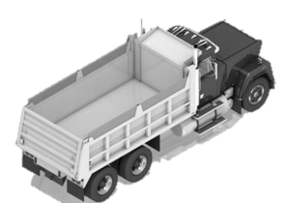
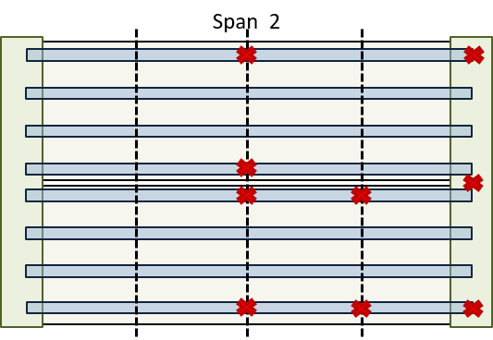
Phase 3 Testing: Instrumentation Plan
Notes:
A test was therefore designed that included an instrumented test-vehicle.
It was instrumented at the four corners of the dump body to capture the roll, pitch and bounce of the main mass.
Actually had to locate the front sensors on the chassis
The structure was instrumented to capture the induced vibration (of multiple modes) along the length of the viaduct.

Slide 43
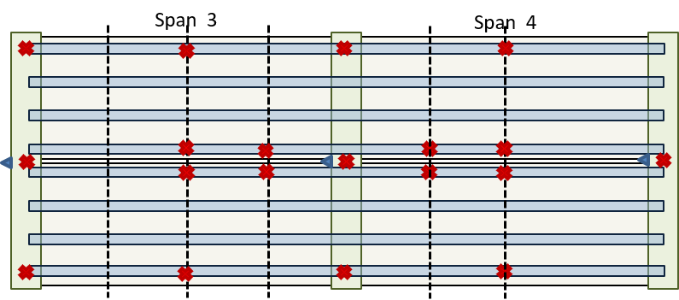
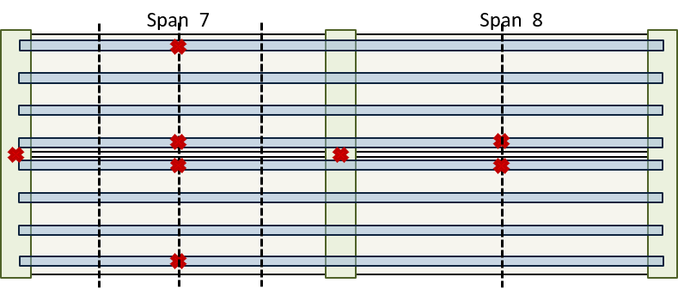
Phase 3 Testing: Instrumentation Plan

Slide 44
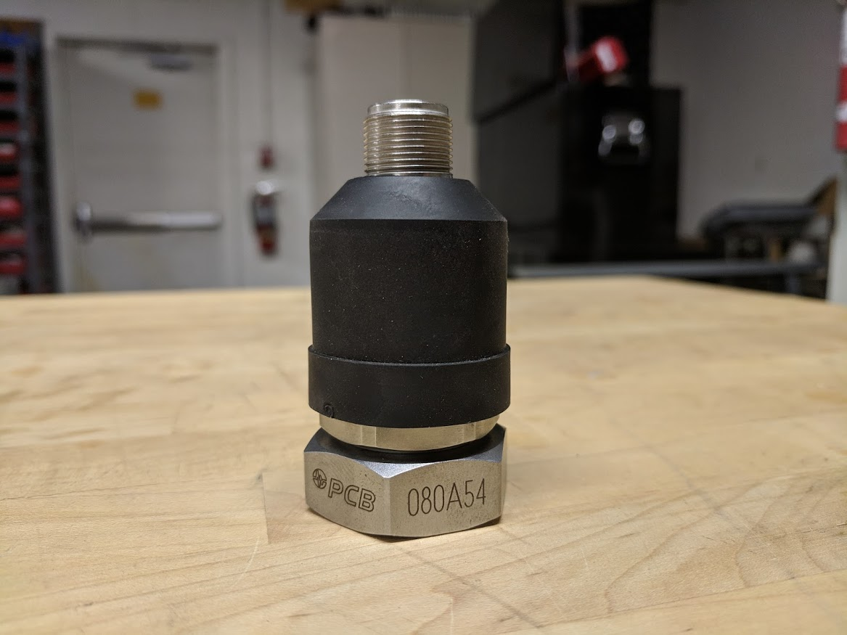

Phase 3 Testing: Test Activities
Wheel Location | Weight
Passenger Front | 6960 | lb
Passenger Middle | 11680 | lb
Passenger Rear | 12000 | lb
Driver Front | 6500 | lb
Driver Middle | 12180 | lb
Driver Rear | 12080 | lb
Total | 61400 | lb
36 accelerometers installed on bridge
6 accelerometers installed on truck
3 DAQs. Synchronization provided by GPS time (±100 ns)
14 Truck runs across bridge
Run # | Lane | Direction of Travel | Average Speed (mph) | Traffic Conditions
1 | L | WB | 60 – 30 | Heavy
2 | R | EB | 35 | Light
3 | R | WB | 42 | Moderate
4 | R | EB | 25 | Moderate
5 | L | WB | 40 – 0 | Heavy
6 | L | EB | 40 | Light
7 | L | WB | 15 | Heavy
8 | L | EB | 47 | Light
9 | L | WB | 58 | Light
10 | R | EB | 20 | Light
11 | R | WB | 10 | Moderate to light
12 | L | EB | 40 | Light
13 | R | WB | 35 | Light
14 | R | EB | 40 | Light
Notes:
The test therefore required
36 accelerometers installed on the structure;
6 on the truck
And 3 DAQs
However, because one would be on a moving vehicle, synchronization between DAQs had to be provided wirelessly.
This was accomplished with a National Instruments GPS module which provided time stamps with ±100 nano-second accuracy.
It took 2 days to install the bridge sensors.
The test truck was provided by PennDOT
It was loaded and weighed the morning of the test.
14 runs were performed

Slide 45

Phase 3 Testing Results: Truck Acceleration
 | Before Bridge (A) | On Bridge (B) | % Increase
Driver Front | 0.042 g | 0.101 g | 140.0%
Driver Rear | 0.078 g | 0.244 g | 213.2%
Passenger Front | 0.040 g | 0.095 g | 134.8%
Passenger Rear | 0.076 g | 0.231 g | 203.4%
Notes:
This plot is of the vehicle acceleration for a typical crossing
(Filtered with 20Hz cut-off)
The truck is clearly experiencing much greater vibration when on the bridge.

Slide 46
Phase 3 Testing Results: Truck Acceleration PSD
Notes:
Furthermore, low frequency vibrations of the truck are being excited.

Slide 47
Phase 3 Testing Results: Truck Acceleration vs Speed
RMS performed on filtered truck acceleration data over the time period when the truck was on the bridge.
Plotted values are the average RMS values for the rear accelerometers
Notes:
As the speed of the truck increased, so did the average level of acceleration

Slide 48
Phase 3 Testing Results: Bridge Acceleration
Run 6
Notes:
Similarly, the bridge appears to be significantly excited at low frequencies when the truck enters the span.

Slide 49
Phase 3 Testing Results: Bridge Acceleration
Run 6

Slide 50
Phase 3 Testing Results: Bridge Acceleration
Run 6

Slide 51
Phase 3 Testing Results: Bridge Acceleration
Span 2
Avg. Span 3 & 4
East-Bound Right-Lane | Girder 8
East-Bound Left-Lane | Girder 5
West-Bound Right-Lane | Girder 1
West-Bound Left-Lane | Girder 4
Notes:
And the average acceleration of the bridge also increases as the truck speed increases.

Slide 52
Phase 3 Testing: Conclusions
Confirmed: This structure is experiencing large vehicle-induced vibrations
A single truck is capable of inducing vibrations in the bridge that lead to dynamic amplification of bridge responses.
The acceleration of the truck increases immediately after entering the bridge as low frequency (1.5-4Hz) vibrations are excited.
The acceleration of the bridge increases very soon after the truck enters the respective span as low frequency (2-4Hz) vibrations are excited.
The magnitude of vehicle vibrations increases with increased vehicle (horizontal) speed.
The magnitude of bridge vibrations increases with increased vehicle (horizontal) speed.
The lane and direction of travel of the truck does not have a significant influence on the magnitude of either vehicle or bridge vibrations.
Simulation is required to provide understanding of the mechanisms and influential parameters associated with dynamic amplification.
Notes:
This test provided the evidence that the bridge is experiencing dynamic amplification due to VBI
However, a “digital twin” is required to understand the physical mechanisms behind the observed phenomena.

Slide 53
Experimental Approach
Phase 1 – Quantify the levels and spatial variation of vibration
Phase 2 – Detailed characterization of structure by monitoring operational responses
Phase 3 – Development and calibration of an FE model
Phase 4 – Synchronized bridge/vehicle monitoring
Vehicle System
Interface
Bridge System
Direct measurement of bridge profile
Phase 5 – Simulation of bridge/vehicle interaction

Slide 54


VBI Model Validation
Experimental and Calibrated FEM Natural Frequencies (Hz)
 | Exp. | LUSAS FEM | % diff
Mode 1 | 2.00 | 2.033 | 1.5%
Mode 2 | 2.03 | - | -
Mode 3 | 2.10 | 2.072 | 1.4%
Mode 4 | 2.44 | 2.493 | 2.0%
Mode 5 | 2.51 | - | -
Mode 6 | 2.54 | 2.496 | 1.6%
Mode 7 | 2.83 | 2.821 | 0.4%
Mode 8 | 2.93 | - | -
Mode 9 | 3.20 | 3.137 | 1.9%
Mode 10 | 3.34 | - | -
Mode 11 | 3.52 | - | -
Mode 12 | 3.56 | 3.628 | 2.0%
Mode 13 | 3.56 | 3.629 | 2.0%
PEB Model
Notes:
Another FE model was constructed similar to the one previously presented.
However, this model was constructed using a software that had the capabilities of simulating moving masses.
Plate-eccentric-beam model. Nearly all components on the same plane. True geometry represented with offsets.
Also calibrated with the experimental mode shapes and frequencies

Slide 55
VBI Model Validation: LUSAS Moving Mass Analysis
Eigenvalue analyses to obtain the undamped modes of vibration
Moving unit load analysis
Linear superposition to compute mode participation and total response.
Assumptions
The system is linear in terms of geometry, material properties and boundary conditions.
There is no cross-coupling of modes caused by the damping matrix (reasonable for low damped structures).
There is no loss of contact between the unsprung masses (wheels) of the spring-mass systems and the structure at any time during the analysis
Only vertical motion of the spring-mass systems is considered in a moving mass analysis.
Mass of the spring-mass systems are not included in the eigenvalue solution

Slide 56
VBI Model Validation: Importance of Profile
Mid Span 3 (FEM)
Vehicle Model
Notes:
Initial simulations did not include any profile, and it soon became clear that there was no hope of recreating the observed responses without it
Therefore, the profile was measured with a profilograph. The resulting profile was then included in the simulations.

Slide 57

VBI Model Validation
 | Value | Units
ks | 30000 | lb/in
cs | 241 (7%) | lb-s/in
ms | 98.42 | lb-s²/in
mu | 20.72 | lb-s²/in
Notes:
This plot demonstrates the ability of the FE model to simulate VBI and the response of the test truck.
This agreement was obtained after adjusting vehicle parameters.

Slide 58
VBI Model Validation
Span 2
Span 3
Span 7
Notes:
Similar agreement was achieved for bridge responses.
Some disagreement is expected since the bridge was not closed to outside traffic.

Slide 59

VBI Model Validation: Quantifying Error
$$MAE=\frac{1}{n}\sum_{i=1}^{n}{\left|Y_{i}−{\hat{Y}}_{i}\right|}$$
 | Run 3 |  | Run 14
 | MAE_DTW (g) | % MAE_DTW | MAE_DTW (g) | % MAE_DTW
Truck (Avg. Rear) | 0.0224 | 2.40% | 0.029 | 3.53%
Span 2 | 0.0031 | 4.14% | 0.008 | 5.51%
Span 3 | 0.0049 | 4.13% | 0.007 | 4.18%
Span 4 | 0.0049 | 4.67% | - | -
Span 7 | 0.0056 | 7.97% | 0.006 | 6.12%
 | Run 3 |  |  | Run 14
 | Max Exp. | Max Sim. | %Diff. | Max Exp. | Max Sim. | %Diff.
Truck (Avg. Rear) | 0.9352 | 0.6345 | -32.15% | 0.825 | 0.738 | -10.58%
Span 2 | 0.0750 | 0.0890 | 18.58% | 0.137 | 0.210 | 53.61%
Span 3 | 0.1177 | 0.1190 | 1.09% | 0.162 | 0.225 | 38.31%
Span 4 | 0.1055 | 0.1230 | 16.68% | - | - | -
Span 7 | 0.0705 | 0.0926 | 31.48% | 0.100 | 0.168 | 68.84%
Notes:
Methods:
Mean absolute error,
error between maximum values,
dynamic time warping

Slide 60
VBI Model Validation: Dynamic Time Warping
Warped
Notes:
What DTW does

Slide 61
VBI Modeling: Conclusions
The VBI modeling and validation efforts succeeded in producing a model that could simulate VBI. The following conclusions were also made.
A validated 3D FE model is capable of simulating bridge-vehicle interaction if roadway profile is included and accurately positioned on the model.
A single degree-of-freedom vehicle model is adequate for simulating VBI and provides a conservative estimate of bridge response.
The large vibrations of the “test” structure may be principally attributed to the roadway profile.
Notes:
The main achievement of this phase (modelling) was demonstrating the capabilities of the FE model and simulations.

Slide 62

Experimental Approach
Phase 1 – Quantify the levels and spatial variation of vibration
Phase 2 – Detailed characterization of structure by monitoring operational responses
Phase 3 – Development and calibration of an FE model
Phase 4 – Synchronized bridge/vehicle monitoring
Vehicle System
Interface
Bridge System
Direct measurement of bridge profile
Phase 5 – Simulation of bridge/vehicle interaction
Notes:
At this stage of research we have developed a firm grasp on the mechanisms behind VBI and confidence in the ability to simulate it

Slide 63
Inductive Research Strategy
Demonstrate Comprehensive Understanding of VBI
Phase 1 – Identify and characterize “test” structure through field testing. Develop FE models.
Phase 2 – Perform detailed characterization of VBI on test structure. Refine FE model.
Phase 4 – Identify methods for estimating and predicting dynamic amplification
Phase 5 – Investigate VBI mechanisms with sensitivity analysis of FE model parameters
Phase 6 – Leverage VBI simulation tools to address some of the challenges facing bridges associated with dynamic response.
Develop Practical Tools & Actionable Knowledge of VBI
Notes:
Now we could move on to investigating various facets of VBI and produce something of value to the practice.

Slide 64

VBI Modeling: System Components
The mass of bridge excited by the vehicle-induced forces
The stiffness of the bridge
The mass of the vehicle
The suspension characteristics of the vehicle
The vehicle velocity
The roadway profile
Full FE model is not always practical
Notes:
Review of what was learned from the experimental activities.
All the mechanisms can be represented in an FE model as demonstrated.
However, this is impractical for most practicing engineers.

Slide 65




Estimating Dynamic Amplification: Simplified Model
Notes:
I therefore sought to develop a simplified representation of the problem.
I started with existing models (which I could code and validate)
I then combined these models into a single 2-DOF model

Slide 66


Estimating Dynamic Amplification: Simplified Model
$$ψ\left(x\right)=\sin\left(\frac{πx}{L}\right)$$
$$p_{0}=k_{t}∗\left(u_{t}−u_{b}−∆\right)+c_{t}\left({\dot{u}}_{t}−{\dot{u}}_{b}−\dot{∆}\right)$$
Vehicle DOF: $m_{t}{\ddot{u}}_{t}+{c_{t}∗\left({\dot{u}}_{t}−{\dot{u}}_{b}−\dot{∆}\right)+k}_{t}∗\left(u_{t}−u_{b}−∆\right)+m_{t}g=0$
Beam DOF: $\tilde{m}{\ddot{z}}_{b}+\tilde{c}{\dot{z}}_{b}+\tilde{k}z_{b}+\left[k_{t}∗\left(u_{b}−u_{t}+∆\right)+c_{t}\left({\dot{u}}_{b}−{\dot{u}}_{t}+\dot{∆}\right)\right]∗\sin\left(\frac{πvt}{L}\right)=0$
Notes:
This model uses generalized coordinates to reduce a beam to single degree of freedom by describing the deformation of the beam with a shape function.
A half sine function was chosen as it accurately captures the first mode of vibration.
Equations of motion were developed. Then organized into state-space matrices and codified.

Slide 67

Simplified VBI Model: Implementation
Reduce bridge to single beam
Equivalent beam stiffness based on midspan deflection
Single Span: $EI= K_{mid}∗\frac{2L^{3}}{π^{4}}$
Two-Span: $EI= K_{mid}∗\frac{L^{3}}{π^{4}}$
Distributed mass based on nat. freq.
$m_{b}=\frac{EIπ^{4}}{ω_{n}^{2}L^{3}}$
Reduce vehicle to SDOF
Mass based on total weight (or rear axles)
Suspension stiffness based on nat. freq.
$k_{v}=ω_{v}^{2}∗m_{v}$
Damping ratio
Notes:
However, this model requires beam parameters, while a real structure has 3D distribution of mass and stiffness.
Therefore, the bridge had to be reduced to a single beam by computing equivalent beam stiffness and mass.
Similarly, the vehicle was reduced to a single sprung-mass

Slide 68
Simplified VBI Model: Shortcomings
Shape function limitations
Accurate for only 1st mode
Inaccurate for point loading (especially 2-span)
Single beam representation
Ignores variation in transverse load distribution
Underestimates bridge mass
SDOF vehicle model
Linear vehicle suspension stiffness (tires remain in contact)
Single mode of vibration
Distributed loads condensed to point load
Notes:
There are several limitations to this simplified model

Slide 69



Simplified VBI Model: Performance Assessment
(6) 3D FE Models based on 3 real structures
Span Lengths: 140 ft, 100 ft, 40 ft.
Natural Frequencies: 2.0 Hz; 4.0 Hz; 9.95 Hz
Stiffness values obtained from midspan displacements of girder beneath travel path due to twin point loads totaling 1 lb., spaced 6’ apart at midspan on the vehicle path
12 artificial profiles (ISO 8608)
3 real profiles
Vehicle models created for each bridge
3’
3’
½ lb
½ lb
 | 40 ft span | 100 ft span | 140 ft span
Mass | 200 | 200 | 200 | slinch
Spring Stiffness | 8.7929E+05 | 1.6150E+05 | 4.9846E+04 | lb/in
Damping Coefficient | 2652.23 (10%) | 1136.67 (10%) | 631.48 (10%) | lb-s/in
Damped Natural Frequency | 10.5 | 4.5 | 2.5 | Hz
Notes:
The ability of this simplified model to estimate dynamic amplification was assessed by comparing its predictions to 3D FE model responses.
The models therefore serve as the “ground” truth because there are too few samples from real structures to properly assess the wide range applicability of the model.
6 FE models were created based on real structures. (Dynamic testing had been performed for each)
They had a range of geometry and dynamic characteristics.
From these models, equivalent beam stiffness and mass was determined. Test vehicles were also created with “bounce” frequencies similar to the structure.
Most of the profiles were artificially generated, while 3 were from the measured viaduct profile.
200 slinch = 77.2 kip = 35000 kg

Slide 70
Simplified VBI Model: Performance Assessment
Dynamic amplification values not representative of real structures
Unrealistically rough artificial profiles
Assumption that vehicle tires do not lose contact with the roadway surface
Notes:
The amplification predicted by the simplified model correlated well with that predicted by the 3D FE models. R2 values of 0.948 & 0.913
Furthermore, the simplified model is predominantly conservative (overestimates amplification).
This is due to the reduction of the bridge to a beam, which results in an underestimate of bridge mass (resisting motion).
The amplification factors reported in the plots is no indication of what may be expected on real structures.

Slide 71
Inductive Research Strategy
Demonstrate Comprehensive Understanding of VBI
Phase 1 – Identify and characterize “test” structure through field testing. Develop FE models.
Phase 2 – Perform detailed characterization of VBI on test structure. Refine FE model.
Phase 4 – Identify methods for estimating and predicting dynamic amplification
Phase 5 – Investigate VBI mechanisms with sensitivity analysis of FE model parameters
Phase 6 – Leverage VBI simulation tools to address some of the challenges facing bridges associated with dynamic response.
Develop Practical Tools & Actionable Knowledge of VBI

Slide 72
VBI Parameters: Parametric Study
Simplified VBI Model (Single-Span)
Harmonic Profile with 30 ft. Wavelength
Varied Parameters
Vehicle Speed
Vehicle Suspension Stiffness
Bridge Stiffness (EI)
 | Bridge 1 | Bridge 2 | Bridge 3 | Bridge 4
Span Length | 100 | 100 | 100 | 100 | ft
Mass (total) | 2000 | 2000 | 2000 | 2000 | slinch
EI | 5.603E+12 | 1.261E+13 | 2.241E+13 | 3.502E+13 | lb-in²
Damping Ratio | 1.0% | 1.0% | 1.0% | 1.0%
1st Nat. Freq. | 2 | 3 | 4 | 5 | Hz
 | Truck 1 | Truck 2 | Truck 3 | Truck 4
Mass | 200 | 200 | 200 | 200 | slinch
Spring k | 31582.7 | 71061.2 | 126330.9 | 197392.1 | lb/in
Damping Ratio | 10.0% | 10.0% | 10.0% | 10.0%
Nat. Freq. | 2 | 3 | 4 | 5 | Hz
Notes:
Parametric study was designed to investigate the interaction of vehicle and bridge dynamics.
Therefore, simulations were performed with 4 different bridges and 4 different vehicles with natural frequencies as shown.
The simplified model was employed to simulate vehicle crossings with a harmonic profile.
The profile was created with a single frequency component (30 ft wavelength)
Therefore, the profile would induce a force equal to the speed divided by the feature wavelength.

Slide 73

VBI Parameters: Bridge & Vehicle Dynamics
Contact Force Amplification
Bridge Displacement Amplification
Forcing Frequency (Hz)
Bridge Response
Contact Force
Notes:
In this way the response of the vehicle and bridge to varying forcing frequencies is simultaneously investigated.
The above plots show that the bridge response is greatest when the profile is inducing force with a frequency matching the bridge frequency.
Similarly, the vehicle response is greatest when the profile forcing frequency matches its own frequency
These plots also show an interaction between vehicle and bridge dynamic characteristics.
Bridge response is maximized when the bridge and vehicle natural frequencies match.
The interaction of vehicle and bridge dynamic characteristics was further investigated with additional simulations

Slide 74
VBI Parameters: Matching of Vehicle and Bridge Frequencies
 | Freq. Factor
Bridge1 | 1.24
Bridge2 | 1.14
Bridge3 | 1.18
Bridge4 | 1.12
Real profile used
Vehicle suspension stiffness varied to achieve frequency as a ratio of bridge frequency
Notes:
The same bridge models (simplified) were again used,
but for each bridge model, multiple vehicles were created with natural frequencies assigned as a ratio of the bridge natural frequency.
These results suggest that the worst-case condition actually occurs when the vehicle natural frequency is 10 to 20% higher than the bridge’s.

Slide 75
VBI Parameters: Profile - Phase Angle Distribution
Notes:
Roadway profile was found to be extremely influential to bridge dynamic amplification and numerous other research have reached the same conclusion.
Therefore, profile parameters were next investigated.
It is common to characterize a profile by frequency content.
However, by describing the profile in the frequency domain, spatial characteristics are lost.
For instance, consider a profile composed of multiple harmonic functions. The phase angles of each function will determine what the final profile will look like.
The two plots above were created with the same harmonic functions, but with different phase angles.
The resulting profiles are visibly different, but seem similar.

Slide 76
VBI Parameters: Profile - Phase Angle Distribution
Notes:
The bridge response to these two profiles was determined by simulating a vehicle crossing with a 3D FE model.
It is clear that although the two profiles are similar and have identical frequency content, their effect on bridge response is very different.

Slide 77
VBI Parameters: Profile - Location
Artificial profile used
Simplified VBI model used
Notes:
This is further demonstrated by comparing the bridge response to one profile whose position is varied between simulations.
As can be seen the effect of a profile is dependent not only on the features it contains, but the specific position of the profile on the bridge.
Therefore it can be concluded that the profile cannot be reduced to a few parameters when trying to estimate bridge dynamic amplification.

Slide 78
VBI Parameters: Conclusions
Harmonic profile content with spatial wavelengths resulting in forcing frequencies similar to the bridge’s natural frequency induce the greatest dynamic bridge response.
Bridge dynamic responses are amplified when the vehicle natural frequency is 10-20% greater than that of the bridge.
Harmonic content alone cannot describe the vibration inducing potential of a profile.
Position of the profile and phase angle distribution of harmonic components have significant effect on bridge response.
Transient features effect bridge response.
Notes:
The parametric studies therefore concluded that

Slide 79
Inductive Research Strategy
Demonstrate Comprehensive Understanding of VBI
Phase 1 – Identify and characterize “test” structure through field testing. Develop FE models.
Phase 2 – Perform detailed characterization of VBI on test structure. Refine FE model.
Phase 4 – Identify methods for estimating and predicting dynamic amplification
Phase 5 – Investigate VBI mechanisms with sensitivity analysis of FE model parameters
Phase 6 – Leverage VBI simulation tools to address some of the challenges facing bridges associated with dynamic response.
Develop Practical Tools & Actionable Knowledge of VBI

Slide 80
Applications in VBI: Profile Smoothness
Rolling Straightedge
Programmatic Application
Linearly interpolate to create a straight line between the first and last point
Account for perpendicular deviation
Find and reduce points that exceed the interpolated line plus the vertical deviation
Common Limits
1/8 to ¼ inch deviation
Over 10 to 16 feet
Notes:
If the roadway profile is the principle driver of high dynamic amplification, what degree of profile smoothness will prevent large dynamic response.
The most common smoothness criteria is IRI. However, this is a performance metric (cannot directly describe the profile).
Rolling straightedge is the most common metric for localized smoothness.
I made an program that could implement the straightedge criteria on a profile (measurement).

Slide 81
Applications in VBI: Rolling Straightedge
Effect of 1/8th inch over 10ft demonstrated with FE model of a single 140 ft. span with the 2.5 Hz vehicle
Notes:
I first examined the ability of the common criteria: 1/8” over 10 ft.
It fails to reduce amplification to reasonable levels

Slide 82
Applications in VBI: Rolling Straightedge
Effect of straightedge length and deviation limit investigated with simplified model (140ft, single-span)
Notes:
More simulations; Varied both criteria
The straightedge length determined the wavelength of the feature it can smooth.
If the goal is to smooth features resulting in 2Hz forcing frequencies, the straightedge length should be at least 30 feet.
Perhaps a better smoothness metric should be developed that is more representative of possible intervention techniques (grinding).

Slide 83
Applications in VBI: Truck Platoons
Platoon Parameters:
Number of vehicles
Individual vehicle dynamics (mass and suspension properties)
Vehicle spacing
Speed
Simulations Performed with:
3D FE Models
Real Profile
Vehicle 5
1200 in/sec (68 mph)
Constant parameters set to provide upper-bound for bridge responses
Notes:
This scenario of repeated trucks is sometimes referred to as a truck platoon or a truck train.
Parameters
The number of vehicles was first investigated and bounded to reduce the computational load of subsequent simulations.
4 vehicles were used for all subsequent platoon simulations.

Slide 84



Applications in VBI: Truck Platoons
100 ft. Single-Span
140 ft. Single-Span
Notes:
Results from single span simulations show:
At small spacings, the static effect increases, but the dynamic amplification is less than what it would be for a single vehicle.
Peak amplification is observed when the vehicle spacing is near 60% of the bridge length, and reaches the level for a single vehicle at approximately 75% of bridge length.

Slide 85


Applications in VBI: Truck Platoons
Span 1
140 ft. 2-Span
Span 2
Notes:
Results from simulations with a 2-span model are a little more messy.
Again, at practical (small) spacing, amplification is no greater than for a single vehicle
The responses at larger spacings demonstrates the unique dynamic behavior of 2-span bridges with repeated loading. The length of time the structure is excited permits occasions when the entering vehicle reinforces the vibrations induced by the previous vehicle.

Slide 86
Multiple Vehicles & VBI: Conclusions
Traffic and truck platoons can result in increased dynamic amplification because a single truck can induce the bridge conditions that result in increased dynamic response (≈20%).
As spacing between vehicles decreases and more vehicles are present on the bridge, the static load effect increases, but the dynamic amplification will likely be less than for a single vehicle.
When designing for truck platoons, if static analysis accounts for multiple simultaneous vehicles, the dynamic amplification factor for a single vehicle can be used to conservatively account for the total dynamic response.

Slide 87
Research Strategy
Demonstrate Comprehensive Understanding of VBI
Phase 1 – Identify and characterize “test” structure through field testing. Develop FE models.
Phase 2 – Perform detailed characterization of VBI on test structure. Refine FE model.
Phase 4 – Identify methods for estimating and predicting dynamic amplification
Phase 5 – Investigate VBI mechanisms with sensitivity analysis of FE model parameters
Phase 6 – Leverage VBI simulation tools to address some of the challenges facing bridges associated with dynamic response.
Develop Practical Tools & Actionable Knowledge of VBI

Slide 88
Conclusions
The dynamic amplification of a structure is the result of bridge and vehicle dynamics and their interaction.
The excitation of the two systems is largely due to the profile which imposes vertical displacement of the vehicle.
At higher vehicle speeds the induced force is increased.
The bridge mass is most excited by profile content that produces forcing frequencies close to its own natural frequency, but other influential profile attributes cannot be parameterized.
The bridge response is maximized when the vehicle’s natural frequency is 10-20% higher than the bridge’s.
Notes:
Profile phase angles, positioning and transient features cannot be reduced to parameters but have a large effect

Slide 89
Conclusions Continued
Simulation with 3D FE models, single DOF vehicle representation and modal superposition methods can effectively simulate VBI for the purposes of predicting dynamic amplification.
<10% MAE for warped signals
Dynamic amplification for common multi-girder highway bridges can be conservatively estimated with a simplified 2-DOF model.
R² values of 0.948 & 0.913

Slide 90
Recommendations
If a bridge is experiencing high dynamic amplification
Likely due to profile; confirm by measuring and simulating (simplified model)
If profile is the culprit, fix by making smooth or mitigate by reducing vehicle speed
High dynamic amplification may be prevented by
Enforcing smooth profile with straightedge length of 30ft or as determined appropriate for specific bridge through simulations with simplified model.
Increasing bridge stiffness such that it’s first natural frequency is outside the range of traffic
Notes:
If the bridge is exhibiting high dynamic amplification, the profile is likely the culprit.
It should be confirmed by measuring the profile.
Rolling straightedge may be used with long straightedge lengths, but a more practical metric should be developed
Reducing vehicle speed also reduces the function of the bridge by reducing mobility. Therefore, this should be a last resort or for special cases (i.e. oversized loads)
Try to get bridge above traffic frequency (5 Hz). This should be verified with truck population statistics.
Special consideration should be paid to 2-span bridges.
Deflection limits do less to limit bridge vibrations because they are more flexible in vibration than in gravity loading.

Slide 91
Recommendations
Truck platoons are not likely to threaten bridge performance at AASHTO limit states
However, other limit states (durability) may be compromised by the dynamic (cyclic) response induced by truck platoons
Notes:
From a life-safety or strength limit state perspective, no.
If the bridge has the capacity (with normal amplification factors) for the increased static load, it will likely also handle the dynamic response.
However, they may pose a threat to fatigue life as they will likely produce more dynamic response and more loading cycles.
This is further reason for designing stiff bridges that have natural frequencies above traffic and are less likely to experience large vibrations.

Slide 92
Significance of Research
The key underlying mechanisms for large dynamic amplification on highway bridges were established through field testing and simulation studies.
Simple and complex models were developed, validated, and shown to be capable of simulating vehicle-bridge interaction for the purpose of estimating dynamic amplification for design or evaluation.
These models were leveraged to develop a series of recommendations for how dynamic amplification can be addressed or avoided.

Slide 93
Future Work
Quantify risk by analyzing a population of profiles
Improve simplified models
Investigate bridge types that cannot be represented with the simplified model (curved, heavily skewed, non multi-girder, non-prismatic)
Identify and assess better smoothness criteria
Examine dynamic amplification of shear
Investigate the effect of dynamic response on long-term performance and durability
Examine impact of other profile features (i.e. bump at beginning of bridge)
Notes:
The simulation studies used mostly artificial profiles and thus, while the results are likely upper bounds in terms of expected dynamic amplification,
The probability of a bridge having a problematic profile cannot be quantified.
The simplified models can be improved by including more modes (especially 2-span)
Effect of wheel distribution for short bridges
As mentioned previously, smoothness criteria should be developed that is practical for realistic mitigation techniques (grinding or overlaying machines)
These studies only examined amplification of midspan responses (dominated by bending).
The amplification of shear is likely to be less than for midspan (bending) because it is less effected by the acceleration of the bridge mass
But it should still be investigated
The cyclic nature of dynamic response is likely to reduce fatigue life.
Also, the profiles used in simulations did not consider large transient features
These could have significant impact on bridge response
Some features that could be present include
the bump at the beginning of the bridge
or undulations due to deck pour sequencing
Others…
Dynamic amplification on railway bridges

Slide 94
End
Understanding Vehicle-Bridge Interaction through Field Measurements and Model-Based Simulations
John Braley

Slide 95
Applications in VBI: Traffic
8 different vehicles
3 HS20 trucks
1 dump truck
1 tractor-trailer
3 small passenger vehicles
36 vehicles per pattern
Simulations performed with 140 ft, 2-span, 3D FEM
Real profile used
 | Num. of Vehicles | Min. Spacing | Max. Spacing
1 | 36 | 20 ft. | 100 ft.
2 | 36 | 40 ft. | 200 ft.
3 | 36 | 60 ft. | 300 ft.
4 | 36 | 80 ft. | 400 ft.
5 | 36 | 100 ft. | 500 ft.
6 | 36 | 280 ft. | 1400 ft.
Amplification
Notes:
Next, the effect of repeated loading was investigated by considering traffic patterns whereby different vehicles with varied spacing traversed a bridge.
6 traffic patterns were created by randomly sampling 8 different vehicles and spacing between vehicles.
Each pattern consisted of 36 vehicles
The dynamic amplification consistently exceeded what a single vehicle would produce.

Slide 96

Applications in VBI: Traffic
Bridge initial conditions effect bridge response to final vehicle
Worst case when preceded by another truck
Notes:
The bridge response the final vehicle in each traffic pattern is plotted.
As can be seen the initial conditions (motion) of the bridge can significantly effect bridge response.
It was also observed from these simulations that the maximum bridge response occurred when one truck followed another.
Therefore, additional simulations would be performed with repeated trucks.

Slide 97
Significance of Research
What can be done if a bridge is exhibiting high dynamic amplification?
Likely due to profile; confirm.
If profile is the culprit how to mitigate
Smooth profile – Rolling straightedge inadequate at common limits
Reduce vehicle speed
Notes:
If the bridge is exhibiting high dynamic amplification, the profile is likely the culprit.
It should be confirmed by measuring the profile.
Rolling straightedge may be used with long straightedge lengths, but a more practical metric should be developed
Reducing vehicle speed also reduces the function of the bridge by reducing mobility. Therefore, this should be a last resort or for special cases (i.e. oversized loads)

Slide 98
Thesis Major Conclusions
The dynamic amplification of a structure is highly dependent on the specific profile in-situ.
Simplified model provides the practical means to estimate dynamic amplification for individual structures.
Sensitivity studies demonstrated the interaction of VBI parameters
Multiple vehicles or repeated vehicles (i.e. platoons) will produce “dynamic amplification” but no more than a single vehicle.

Slide 99
Significance of Research
Is the current approach for accounting for dynamic amplification adequate?
Dynamic amplification of a structure is highly dependent on the specific profile in-situ.
Cannot be estimated without considering the bridge
Current methods likely to remain conservative at strength limit states (multiple simultaneous vehicles)
A flexible bridge with a rough profile may not fail “design” or “service” limit states, but the cyclic nature and high amplification of ordinary traffic events poses a real fatigue threat.
Notes:
I would contend: “No, current methods are not adequate.”
Because…

Slide 100
Significance of Research
How can the dynamic amplification of an existing bridge be estimated?
Field Testing
Filtering of operational data
Known input
Simulation with measured profile
Notes:
With field testing you can either measure operational dynamic response and estimate static response with filtering
Or…
Perform testing whereby the input is known/controlled. Dynamic response is obtained by crossing the test vehicle at traffic speeds
Or measure the profile and perform simulations

Slide 101
Significance of Research
What are better ways of quantifying VBI?
Dependent on application
3D FE modeling with “moving-mass” analysis
Simplified model is less accurate but conservative and easy to implement
Notes:
When trying to analytically determine dynamic amplification (simulating VBI) there are several options.
Full 3D FE model as demonstrated with case study
Or use the proposed simplified model

Slide 102
Significance of Research
What measures can be taken to ensure a bridge does not experience high dynamic amplification?
Increase bridge stiffness (especially 2-span)
Specify and maintain a smooth profile
Notes:
Try to get bridge above traffic frequency (5 Hz). This should be verified with truck population statistics.
Special consideration should be paid to 2-span bridges.
Deflection limits do less to limit bridge vibrations because they are more flexible in vibration than in gravity loading.
Biggest thing is making sure the roadway profile is smooth

Slide 103
Significance of Research
Do platoons pose additional risk to bridge performance?
Higher amplification may occur when the bridge is subjected to repeated vehicle loading
For small headway spacing, static load effect is increased and dynamic amplification decreases
Use amplification factor as computed for single vehicle
Notes:
From a life-safety or strength limit state perspective, no.
If the bridge has the capacity (with normal amplification factors) for the increased static load, it will likely also handle the dynamic response.
However, they may pose a threat to fatigue life as they will likely produce more dynamic response and more loading cycles.
This is further reason for designing stiff bridges that have natural frequencies above traffic and are less likely to experience large vibrations.

Slide 104
Shortcomings with Experimental Research
Many of the larger studies found bridges with amplification factors between 1.5 and 2, and have identified some of the most influential parameters
However:
Even the largest studies face the issue of whether the studied sample set is representative or comprehensive of the entire bridge population (e.g. Study of 200 bridges in Switzerland consisted mostly of concrete bridges)
Furthermore, the studies often consider too few parameters to fully understand the conditions resulting in amplification issues
These studies have failed to characterize the mechanisms that lead to large dynamic amplification and they offer no quantitative relationships

Slide 105
Shortcomings with Analytical Research
Analytical tools (simulation) provide the ability to investigate the mechanisms driving VBI and amplification. Several analytical studies have echoed the general conclusions of the experimental studies. (e.g. road roughness is a very important parameter)
However:
It is only recently, that software and computing power have made large scale simulation studies possible.
Therefore there is again the issue of small sample sizes and too few parameters investigated
Furthermore, there is little assurance the models are capable of modeling VBI and thus conclusions have been limited to qualitative relationships.

Slide 106
Knowledge Gaps & Vulnerabilities
Dynamic effect of traffic on highway bridges is poorly understood
Inadequacy of current codes has been demonstrated by field experiments (i.e. outliers)
Simulation studies on influential parameters have failed to reach actionable conclusions
Interdependency of influential parameters has been largely overlooked
Established methodologies were developed through statistical means
How has the bridge population changed?
How has traffic changed?
Can a dynamic factor adequately account for VBI?
The impact of changes in the nature of truck loading on bridge dynamics and performance has not been addressed.
Heavier loads, truck platoons may pose a threat to bridge performance while conservatism is reduced
Notes:
Field experiments are limited to the population subset and only serve to demonstrate shortcomings, rather than propose improvements
Simulations have been mostly with simplified models (i.e. single-line girder),
and with only a few parameters to be investigated
and no assurance that the models are capable of simulating VBI

Slide 107

Framework for Investigating Test Structure

Slide 108


FE Modeling of Test Structure
Pedestals & Bearings

Slide 109






FE Modeling: Preliminary Mode Shapes
2.37 Hz
2.73 Hz
3.71 Hz
4.22 Hz
4.25 Hz
4.58 Hz

Slide 110
Phase 2 Testing Results: Acceleration for Typical Event
Notes:
Elliptic filter with 20 Hz cutoff, 40db stopband attenuation, 0.5 dB pass-band ripple

Slide 111
Phase 2 Testing Results: High Acceleration Events
Notes:
High acceleration, but so does a dropped ball bearing produce. We care about low frequency

Slide 112
Phase 2 Testing Results: Bridge Acceleration Frequency Content
Notes:
Welch’s PSD estimate

Slide 113


Phase 2 Testing Results: Acceleration to Displacement
$$\left.Acceleration= \ddot{V}=A∗sin⁡(ωt\right)$$
$$Displacement= −\frac{A}{ω^{2}}∗\sin\left(ωt\right)= −\frac{Acceleration}{ω^{2}}$$
FRF_{A}
FFT
FRF_{D}
iFFT(FRF_{D})
Disp.
ω_{n}²
Notes:
Conclusion: The high accelerations are inducing appreciable bridge deformation
Limitations: Sensors are AC coupled, do not accurately capture content below 0.5Hz. Therefore, only included frequency components above 0.5Hz

Slide 114



Phase 2 Testing Results: Model Calibration
Mode 1
Mode 4
Mode 7

Slide 115



Phase 2 Testing Results: Model Calibration
Mode 9
Mode 12
Mode 13

Slide 116
Phase 2 Testing Results: Leveraging FEM
 | IM = 0.33 |  | IM = 0.75
 | Strength I | Service II | Strength I | Service II
Girder 4 | 1.60 | 1.73 | 1.21 | 1.32
Girder 5 | 1.86 | 1.98 | 1.41 | 1.50
Sources of Conservatism
 | Design | FEM
Distribution Factor | 0.91 | 0.79
Design Load | HL-93 | 204 kip permit load

Slide 117
Phase 2 Testing: Conclusions
This structure is experiencing dynamic amplification in excess of 1.75.
Refined load ratings reveal that there is sufficient reserve capacity to handle the increased dynamic amplification.
The structure’s dominant operational modes of vibration are between 2 and 4 Hz.
The calibrated FE model had parameter values within reasonable bounds indicating that there are no structural abnormalities contributing to the vibration issues.
This phase of testing was unable to identify the cause of the vibrations.

Slide 118
Phase 3 Testing Results: Truck Accels High Freq. Content

Slide 119
Phase 3 Testing Results: Truck Acceleration PSD
PSD computed with data from truck to bridge site
Welch’s improved PSD estimator
(4) 10-second segments
25% overlap

Slide 120
VBI Modeling: Dynamic Amplification

Slide 121



Estimating Dynamic Amplification: In-Situ
 | Point Force | Distributed (Inertial) Force
Displacement | $$∆=\frac{PL^{3}}{48EI}$$ | $∆=\frac{m_{b}L^{3}A_{max}}{π^{4}EI}$
Stress | $$σ=\frac{PLy}{4I}$$ | $$σ=\frac{m_{b}LA_{max}y}{π^{2}I}$$

Slide 122
Estimating Dynamic Amplification: In-Situ
Displacement and Strain gauges preferred over accelerometers (DC-coupled)
Amplification estimated by filtering
Cut-off frequency < nat. freq.; > freq. of loading
Phase shift
Load Testing – Static response directly measured
Test truck should have low damping
Test truck nat. freq. close to bridge
Traverse bridge over range of speeds
Include approach
If high amplification is observed, profile is likely culprit
Profile measurement
Principally concerned with features of 5-50ft.
Minimum resolution: every 10 inches
Include Approach

Slide 123
Estimating Dynamic Amplification: VBI Simulation
Bridge Model
Can accurately represent stiffness and dynamics (validated)
1st natural frequency matching structure
Vehicle Model
Can be reduced to single DOF
Based on real vehicle
Weight → mass
“bounce” freq. → suspension stiffness
Worst-case vehicle
Design-level mass
Damping<10%
Suspension stiffness to yield “bounce” freq ≈ 20% > Bridge 1st nat. freq.
Profile
Accurately located on bridge
Include approach profile (>300 ft.)

Slide 124
Simplified VBI Model: Bridge Vulnerability
Bridges with high 1st nat. freq. fail to be excited by the non-matching (2.8 Hz) vehicle.
Fully loaded trucks most often have first natural frequencies less than 4 Hz
Bridges with high 1st nat. freq. frequencies have reduced vulnerability

Slide 125
Other Simple Models: Roughness Metrics
ISO 8608
IRI

Slide 126
Other Simple Models: Vehicle Only
Same vehicle model as simplified VBI model
Contact force windowed (half sine) while on bridge
Maximum of windowed force reported
Illustrates the importance of considering the bridge in amplification predictions

Slide 127

VBI Mechanisms: Coupling of Vehicle and Bridge
Decoupled:
$$p_{0}=k_{t}∗\left(u_{t}−∆\right)+c_{t}\left({\dot{u}}_{t}−\dot{∆}\right)$$
Coupled:
$$p_{0}=k_{t}∗\left(u_{t}−u_{b}−∆\right)+c_{t}\left({\dot{u}}_{t}−{\dot{u}}_{b}−\dot{∆}\right)$$

Slide 128
VBI Mechanisms: Coupling of Vehicle and Bridge
Flexibility of bridge serves to reduce contact force
Conservative to obtain contact force from decoupled model

Slide 129
VBI Mechanisms: Vehicle Frequency

Slide 130
VBI Parameters: Conclusions
Ignoring the interaction of vehicle and bridge (i.e. computing contact force without consideration of the bridge) results in conservative estimates of bridge response.
Harmonic profile content with spatial wavelengths resulting in forcing frequencies similar to the bridge’s natural frequency induce the greatest dynamic bridge response.
Bridge dynamic responses are amplified when the vehicle natural frequency is 10-20% greater than that of the bridge.
Position of the profile and phase angle distribution of harmonic components have significant effect on bridge response.
Transient features effect bridge response

Slide 131
Thesis Conclusions: Case Study
A validated 3D FE model is capable of simulating bridge-vehicle interaction if roadway profile is included and accurately positioned on the model.
The observed vibrations may be principally attributed to the bridge deck roadway profile. The vehicle is excited by the profile, which in-turn excites the bridge.
The high dynamic amplification does not seem to pose a risk to the structure’s performance (at strength or service limit states).
The bridge exhibits dynamic amplification in excess of 1.75 even under heavy vehicles (compared to AASHTO recommended 1.33).

Slide 132
Thesis Conclusions: VBI Analysis Methods
Amplification factors determined from displacement measurements will be greater (more conservative) than those determined from strain measurements.
Ignoring the interaction of vehicle and bridge (i.e. computing contact force without consideration of the bridge) results in conservative estimates of bridge response.
A simple model that reduces both the bridge and vehicle to SDF systems can reliably predict dynamic amplification and is recommended when FE simulation is impractical.
Bridge responses are greatest when the profile induces oscillation in the vehicle close to the bridge’s natural frequency and when the vehicle’s natural frequency is 10-20% greater than that of the bridge.
Position of the profile and phase angle distribution of harmonic components have significant effect on bridge response.
Current roughness metrics (e.g. IRI and ISO 8608) cannot reliably predict dynamic amplification.

Slide 133
Thesis Conclusions: Applications in VBI
Rolling straightedge criteria with common limits (i.e. 1/8 to ¼ inch deviation over 10 to 16 feet) are not effective at reducing dynamic amplification.
Rolling-straightedge length should be no less than 16 feet for a specified deviation of 1/8th inch, and no less than 30 feet for a specified deviation of ¼ inch.
Traffic and truck platoons can result in increased dynamic amplification because even a single previous truck can induce the bridge conditions (motion) that result in increased dynamic response (≈20%).
As spacing between vehicles decreases and more vehicles are present on the bridge, the static load effect increases, but the dynamic amplification will likely be less than what would occur for a single vehicle.

Slide 134
Objectives
Characterize the mechanisms behind VBI
Role of influential parameters
Identify any shortcomings with current design and assessment methodologies
In which situations are their treatment of dynamic amplification inadequate
Propose modifications
Identify bridge vulnerabilities associated with truck platooning
“Problematic” platoon patterns and vulnerable bridges
Make recommendations related to implementation strategies and policies
Notes:
Difference from previous studies:
Field testing and model calibration will ensure the models are capable of simulating VBI
All influential parameters will be examined simultaneously
Develop actionable conclusions

Slide 135
Background – Vehicle Bridge Interaction
Two dynamic systems
Energy transfer at wheel contact
Motion of one system influences other
Computationally expensive analysis
Highway bridges -amplification factors
m
m
m
m
m
m
VS

Slide 136
State of the Art – Dynamic Amplification
Dynamic Amplification Factors in Codes
Applied to loading model
Developed through survey of existing bridge stock
AASHTO: road roughness – 0.1 to 0.3
Canada/MTO: no. axles – 0.25 (3 or more)
China: 1st natural freq. – 0.05 to 0.40
New Zealand: span length – < 0.30
Europe: span length & no. lanes – 0.1 to 0.3
Japan: span length & bridge type – < 0.35

Slide 137
State of the Art – Dynamic Amplification
Experimental Evaluation
1950’s: AASHTO sponsored testing of 18 bridges
IM dependent on vehicle speed
1956-1957: 52 bridges tested in Canada
IM dependent on road surface irregularities
1958-1981: >200 bridges tested in Switzerland
IM as high as 0.7 for 1st freq. 2-4 Hz.
1980s: 27 bridges tested for OHBDC
High variation in IM’s
Single-subject tests measured IM > code IM

Slide 138
State of Research– Influential Parameters
Vehicle Speed
↑ speed → ↑ DAF
Vehicle Mass
↑ mass → ↓ DAF
Vehicle Suspension
↑ stiffness → ↑ DAF
↑ damping → ↓ DAF
Road Surface Roughness
↑ roughness → ↑ DAF
Span Length
Natural Frequency
Bridge Type
Even though some of these parameters exhibited great influence over dynamic amplification, inconsistent relationships have inhibited revisions to current methodologies.
Poor Correlation

Slide 139
State of the Art – Platooned Vehicles
Lack of research on the effect of platoons on highway bridges
Similar to loading on railway bridges
Large dynamic amplification on railway bridges
Dependent on:
Wheel Spacing
Train Speed
Bridge Span Length
1st Fundamental Frequency (Bridge’s)
Highway bridges are very different from railway bridges

Slide 140



Completed Work – Phase 1
I-76 PENCOYD VIADUCT (1986)
Half section Span 7 and 8
Cross section
Elevation

